Slide 1
Simplify your multi-cloud migrations with Azure Cloud and Fortinet
Notes:
Hi and welcome to the webinar. Today we are focussing on how to Simplify your cloud migration with Fortinet and Azure.
The webinar will be recorded and distributed following the event

Slide 2
Agenda
Topic | Speaker
The Challenge of Cloud Security
Fortinet Cloud Security Differentiation – strength of FortiGUARD Labs + Security Fabric (one OS)
Fortinet Cloud Solutions in AWS use cases: SD WAN – TGW + VPC routing – WAF – Global Load Balancing

Slide 3
The cloud requires
a new approach to security
  Distributed infrastructure
Need visibility and management across clouds and data centers
  Rapidly changing development models
Require solutions that keep pace with speed and agility of modern DevOps
  Expanded Attack Surface
Leverage analytics, AI, ML and Sandboxing and Virtual Patching to detect and block attacks
© Fortinet Inc. All Rights Reserved.
Notes:
The cloud can be just as secure as on-prem computing – but there are challenges that need to be addressed. Challenges that include:
First, we live in a multicloud world. Few organizations are likely to standardize on one cloud –especially not mid to large enterprises or governments. We have found that some 80% of our customers utilize different clouds for different purposes – and over 90% have a mix of on-premises and public cloud deployments. Your security infrastructure should span clouds and data centers. It should consolidate analytics, include central management, and should have to ability to set and enforce the same security policies and reactions where-ever the compute occurs.
Second, the cloud is a hotbed of new development methodologies and tools. Your security solutions should support container-based, micro-segmented architectures, a range of automation tools and should be designed to support modern DevOps methodologies.
Finally, the cloud does bring an expanded attack surface – one that includes orchestration and automation tools, cloud-based services such as storage, analytics, and container services and far more. Complicating this is that in the cloud, security responsibilities are shared between the customer and the cloud vender – let’s see what that means.

Slide 4
Through 2025, 99% of cloud security failures will be the customer’s fault.
99%
Gartner, “Is the Cloud Secure?”
Notes:
Gartner is predicting that 99% of cloud security failures will be due to human error. 99% seems high – but whatever the true number, the message is clear –{click}

Slide 5
Complexity is the Enemy of Security
99%
Gartner, “Is the Cloud Secure?”
Notes:
complexity is the enemy of security
Whether complexity is due to an expanded attack surface, a decentralized dev and post process or just to many security elements that don’t work together – complexity can lead to failures. And that simple truth drives the Fortinet Cloud Security Vision

Slide 6
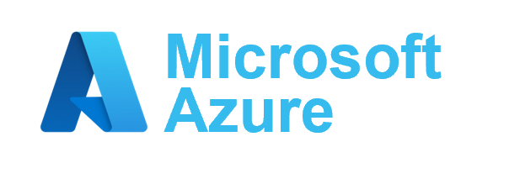

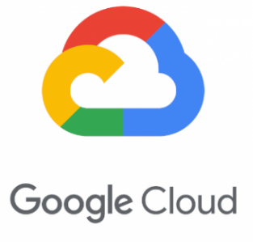
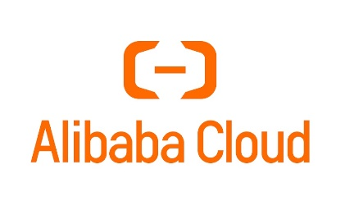
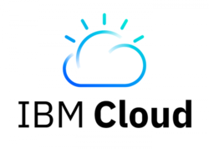

Fortinet Cloud Security Vision
A Seamless Security Fabric
A seamless security fabric that extends across clouds and data centers.
Complete cybersecurity protection,
everywhere you need it.
Driven by Peerless Threat Intelligence
Best-in-class security backed by the leading security threat feeds and research.
Security that is Software Defined and Automated
Agile security, automated, DevOps ready, and container aware.
Notes:
And that leads to our vision, the Fortinet vision for cloud security
The goal here is to provide complete and seamless security wherever your compute occurs. Security that:
[click]
Forms a seamless security fabric – a fabric that extends across clouds and data centers.
[click]
And that security fabric, in turn, must be driven by Peerless Threat Intelligence
[click]
Finally, cloud security must be Software Defined and Automated. We are talking about agile security that works with modern DevOps tools, is container aware and easily automated.

Slide 7















Actionable Threat Intel from FortiGuard Labs
Visibility
Innovation
Actionable Threat
Intelligence
Telemetry
Network
Web
Sandbox
Email
Endpoint
IPS
Application Control
Web
Filtering
Anti-Virus
SECURITY
FABRIC
PROTECTIONS
CERTs
AI / Machine
Learning
Fortinet Distribution Network
Anti-
Spam
Endpoint
Vulnerability
Indicators of Compromise (IoCs)
Enforcement Partnerships
Zero-Day
FortiGuard
Labs
Proactive
Research
Adversary
Playbooks
Security
Blogs
Threat Intel Briefs
Threat Signals
Virtual
Patches
OSINT
Detection and protection in milliseconds
Federated Machine
Learning
CTA feeds
Threat
Intelligence
Services
Trusted
Partnerships
Penetration
Testing
Phishing
Service
Incident
Response
Notes:
You’ve heard us refer to FortiGuard Services and FortiGuard Labs so I wanted to take a few minutes to give you a better understanding of what FortiGuard Labs is and how it benefits you.
This slide provides a nice easy-to-understand overview of how FortiGuard Labs operates. Moving from left to right, you can see all of the different types of information we take in as input, how FortiGuard Labs processes this information into actionable threat intelligence, and the different types of output FortiGuard Labs generates that our customers can take advantage of.
But it also shows the principles that FortiGuard Labs was found on – and what sets us apart. It’s the breadth of our visibility into the threat landscape; our commitment to using innovative technology to accomplish our mission; and the timely delivery of actionable threat intelligence to the Fortinet Security Fabric and Fortinet customers.
Let’s start with visibility.
There’s an old saying in security – “you can’t protect what you can’t see.” In threat intelligence, the more you can see, the more you can know. That’s why the amount of data we pull in and the sources of this data are so important to our efforts.
For example, we have real-time visibility into real-world threats through our telemetry data. This comes from Fortinet security products deployed at customers who have agreed to share their anonymized telemetry data with us. It enables us to cover the entire threat landscape as we see threats at the network level, on endpoints, through the web and email, and those that result from sandbox analysis. With close to 6 million devices across the globe, no one can match our visibility into the threats and attacks that are actually occurring in the wild.
Another example is the visibility that our threat intelligence sharing partnerships provide us. We have hundreds of partner feeds continuously feeding threat data into our analysis pipeline. FortiGuard Labs has been a pioneer in the area of information and threat intelligence sharing:
We co-founded the Cyber Threat Alliance (CTA) in 2014 which is dedicated to the sharing of information and threat intelligence between its members
We are a co-founder of the World Economic Forum’s Center for Cybersecurity created in 2018
We were a contributor to the development of STIX/TAXII protocols that standardize how threat information is shared.
Finally, FortiGuard Labs has the most successful zero-day detection operation in the industry, having discovered over 870 zero-day vulnerabilities to date, far exceeding any other threat intelligence operation.
Fortinet has always been known as an innovator within the industry. That is demonstrated by the fact that Fortinet has been awarded almost three times as many U.S. patents than our closest network security competitor. (Fortinet = 630, FireEye = 227).
FortiGuard Labs is no different because innovation drives everything we do. Hundreds of threat hunters, researchers and analysts use these innovative tools and platforms to take all of the information on the left and turn it into threat intelligence on the right.
An example of this is the use of artificial intelligence and machine learning in our FortiGuard Labs operations. This technology enables our researchers to better understand, classify and protect our customers from malware and attacks. And that translates to a faster, more effective response to in-the-wild malware. This platform ingests and analyzes over 100 billion security events and produces approximately 1 billion security updates every day to Fortinet customers around the world. This enables our customers to stay protected against new, unknown threats across all Security Fabric deployments.
Another example of innovation is the Fortinet Distribution Network. This bi-directional network serves as the conduit for all of that telemetry data we collect from our customer installations – providing us real-world threat information that none of our competitors can match. Second, the Fortinet Distribution Network was also designed to efficiently distribute FortiGuard Labs security protection updates to the Fortinet Security Fabric components deployed in customer networks around the world. Because of its design, FortiGuard Labs is able to update Fortinet security products several times each day and again differentiates us from competitors who are only able to update protections for their products once a day or even once a week.
The commitment to innovation has resulted in better protection for our customers and over 100 U.S. patents on the processing infrastructure used by FortiGuard Labs.
We’re already working on the next generation of artificial intelligence to improve our machine learning processes and threat pattern recognition – federated machine learning. By moving from a centralized analysis server to a distributed model, threat patterns can be detected by distributed learning nodes across an environment instead of just at the central server, enabling a faster local detection and response.
One last thing about innovation at FortiGuard Labs. We built our anti-virus technology from the ground up and now that engine exists in multiple Fortinet products such as FortiGate, FortiMail and FortiWeb. In 2006, we needed sandbox technology to help with our analysis so we built our own sandbox and refined it over the years to the point that in 20XX we released it as a commercial product, FortiSandbox. And in 2014, we started using artificial intelligence in our operations to provide faster and more informed ways to create dynamic signatures. After working and improving on it over 5 years, the commercial product FortiAI was launched in 2019, introducing the Virtual Analyst function that is able to perform the analysis of 25 people.
All of this innovation is done for one purpose – to deliver the best actionable threat intelligence to our customers, in the form of security fabric protections, proactive research and threat intelligence services.
When it comes to actionable threat intelligence, the primary mission of FortiGuard Labs is to protect Fortinet customers from malicious cyber-attacks. Job #1 in this effort is keeping Fortinet security products up to date with the latest threat information so they can detect and protect against cyber-attacks.
The result of FortiGuard Labs’ efforts are delivered across the Fortinet Security Fabric through security updates that contain the latest threat identification and protection information available. And thanks to the Fortinet Distribution Network we are able to update these products multiple times a day. That makes a huge difference for organizations that are fighting attackers that are always innovating themselves.
FortiGuard Labs supplements its threat protection product updates with threat research publications to help our customers better understand and take proactive actions against the threats that affect them. Some examples of this research are:
Adversary Playbooks
Details on specific cyberattack campaigns and the TTPs that adversaries leverage to deploy them. They also provide a detailed MITRE ATT&CK® breakdown of the attack.
Threat Blogs
In-depth research on important threat intelligence subjects such as new malware, new variants or targets and critical vulnerabilities being exploited. This helps our customers better understand attacks and attackers and also details existing protections from Fortinet security products.
Threat Intelligence Briefs
A weekly recap of the incidents and threats you care the most about. This includes alerts on critical vulnerabilities and links to vendor patches.
Threat Signals
Concise technical details about emerging cybersecurity issues, mitigation recommendations and insight from the FortiGuard Labs team in an FAQ style format.
The last category of Actionable Threat Intelligence that FortiGuard Labs provides comes in the form of consulting services. FortiGuard Labs provides a number of threat intelligence services to help organizations identify critical issues and work toward improving their security. These include:
FortiPhish – Phishing Simulation Service
A cloud-based service evaluates how individuals within an organization respond when tested with different phishing scenarios.
FortiPen – Penetration Testing
Provides a technical assessment of the security controls within an organization in order to identify weaknesses on computer hardware infrastructure and software applications.
FortiGuard Responder – Incident Response Service
This service assists clients with the analysis, response, containment, and remediation of security incidents impacting their organizations. There is also a managed detection and response option as well.

Slide 8
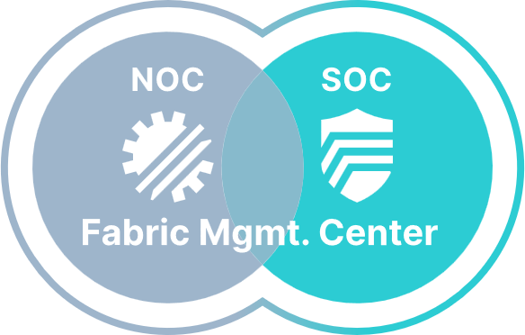





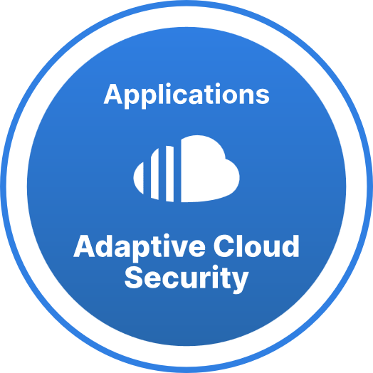
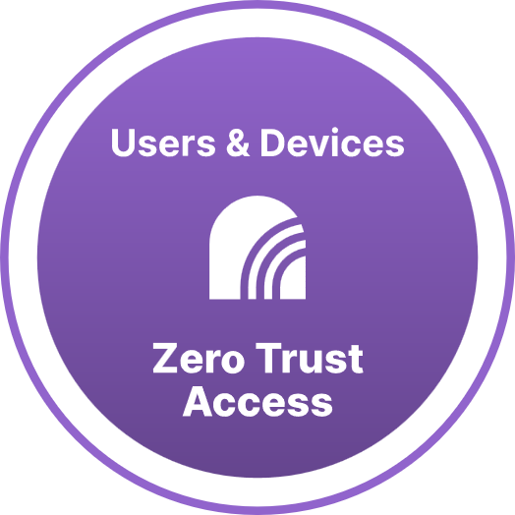
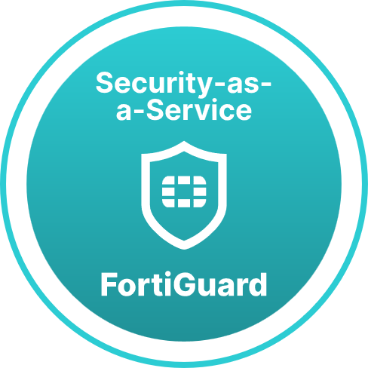
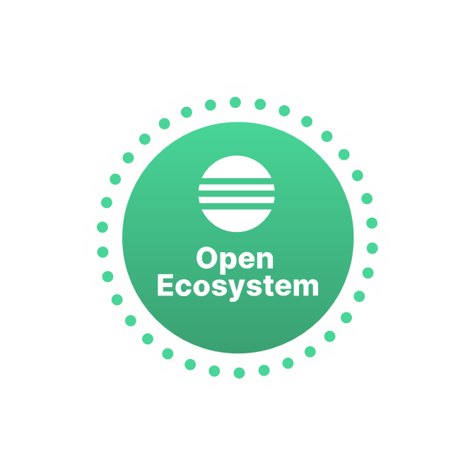
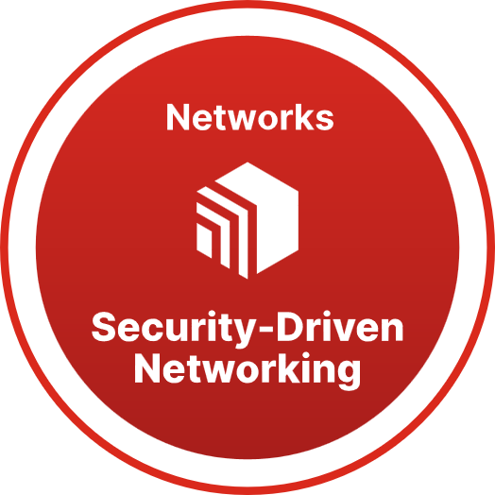
Fortinet Security Fabric
Cybersecurity MESH Architecture
SOC, SOAR, Email, Sandboxing, DLP…
Zero Trust Edge
ZTNA, SD-WAN, Firewall, SWG, CASB, DEM
Secure WLAN/LAN
Access Points, Switching & LTE/5G
Access & Endpoint Protection
Application Journey
Virtual Firewall, WAF, CWP (Data Center, AWS, Azure, GCP…)
Work From Anywhere
ZTNA, Endpoint (EDR, XDR, MDR), Identity (IAM, Token, MFA) & Home Networking
OT Security
Firewall, NAC…
Notes:
Put it all together and you get the Fortinet Security Fabric - a fabric that ties together
Trust edge, secure networking, tools to securely work from anywhere and tools that secure the application journey – into an integrated fabric that is greater than the sum of its parts.

Slide 9
Product Integrations vs a Security Fabric
A SIEM is not a Mesh
Cybersecurity Point Products
Cybersecurity Platform Approach
SOAR
SIEM
ADC
DLP
EASM
SOAR
IAM
CASB
IAM
CASB
XDR
EMAIL
XDR
EMAIL
EPP
EDR
SIEM
WAF
EPP
EDR
WAF
ZTNA
CWP
ZTNA
CWP
NAC
vFW
NAC
vFW
LAN
SWG
LAN
SWG
NGFW
NGFW
Most Vendors
Fortinet Security Fabric
Notes:
Most vendors product integrations are primarily about sharing logs and security events. Microsoft, for example, features hundreds of security “integrations” – which usually means some vendor has agreed to share lots with Azure Sentinel – their Security Incident and Event Manager (SIEM).
This is a big improvement over the days when every security point product was it’s own island. But it still doesn’t exploit the potential gains when security products truly can work together. It is similar to the difference between the Android and the Apple eco system. You may have good reasons to prefer Android – but it is nice how Apple products play together.
Sure, the security fabric consolidates security events and can be used to identity and understand security incidents. But it can do a lot more. You can use the security fabric to detect events from any source in the Security Fabric and apply actions to any destination. You can use automation stitches to trigger a webhook, ban IP addresses, quarantine compromised devices, send emails or slack notifications, kickoff backups – really the only limit is your imagination.
The power of the Fortinet Security Fabric is real – it keeps getting better.

Slide 10
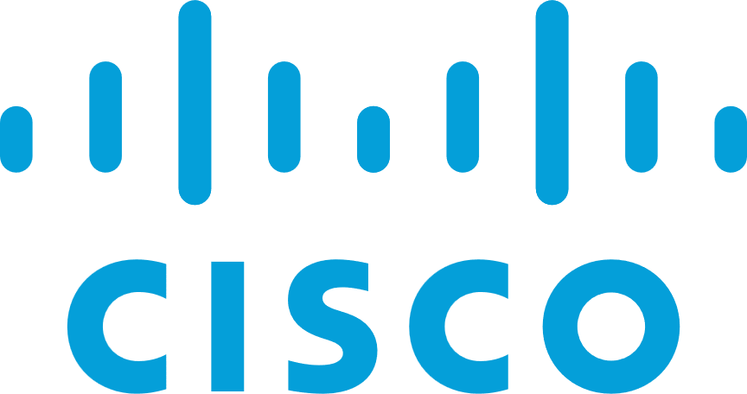


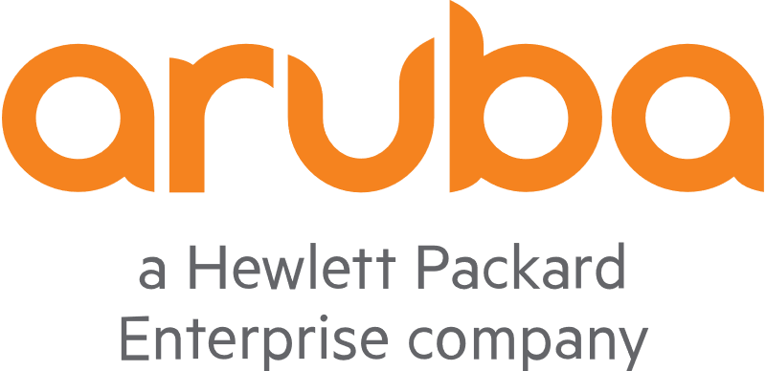
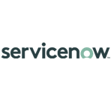
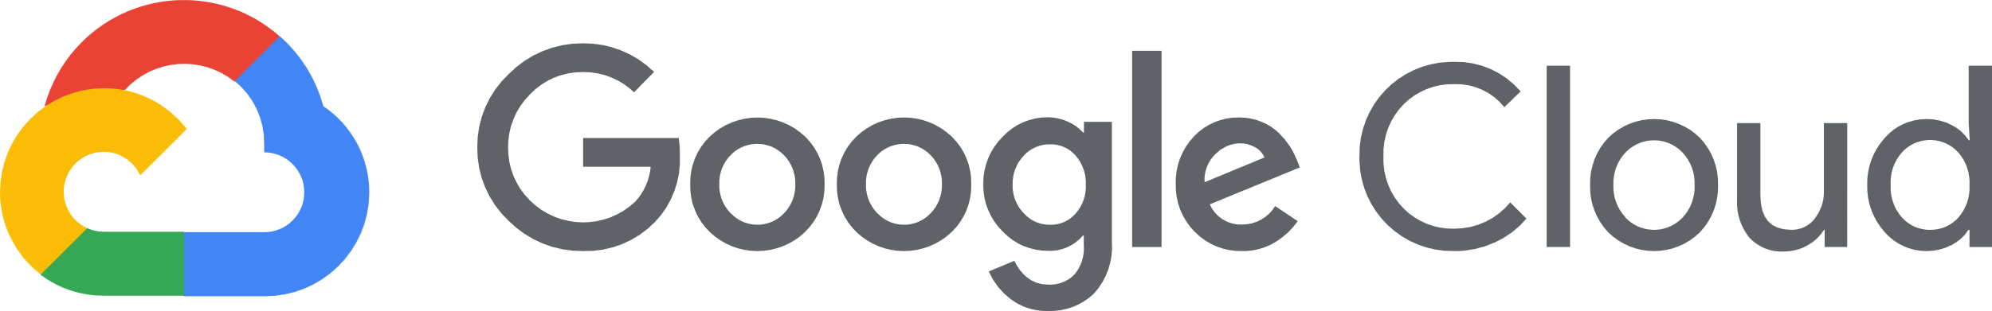
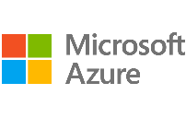
























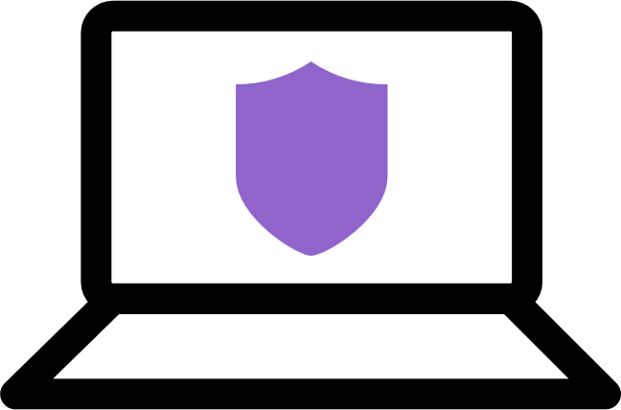
Open Ecosystem
480+ Best-in-class integrated solutions for comprehensive protection
Fabric
Connectors
Fortinet-developed deep integration automating security operations and policies
Fabric
APIs
Partner-developed integration using Fabric APIs providing broad visibility with end-to-end solutions
Fabric
DevOps
Community-driven DevOps scripts automating network
and security provisioning, configuration, and orchestration
Extended
Ecosystem
Integrations with threat sharing initiatives and other vendor technologies
Firewalls
Switching
Wireless
Endpoint
Security
Figures as of March 31, 2021
Note: Logos are a representative subset of the Security Fabric Ecosystem
Notes:
But this on not all.
In increasingly dynamic network environments, security solutions must be tightly coordinated with networking and other IT infrastructure to provide agility in the face of fast-paced and rapidly changing operations. Fortinet Fabric Connectors feature APIs and other interfaces to make them highly extensible platforms.
They provide out-of-the- box or built-in integration mechanisms and orchestration of FortiGate or FortiManager with key SDN and public cloud solutions like Azure.
Fortinet Fabric Connectors for SDN (private clouds) and Cloud (public clouds), formerly known as Fortinet SDN Connector, enable either FortiGate as a standalone system, or FortiManager, which manages multiple FortiGates, to integrate with the third-party SDN or cloud platforms to synchronize dynamic address group objects that the FortiGate firewall policy protects

Slide 11
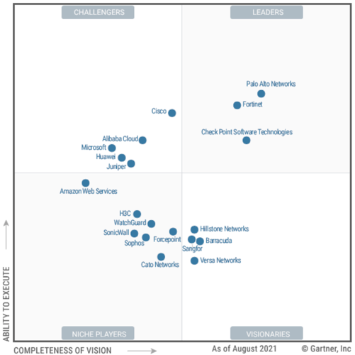
One OS for Networking and Security
Only vendor recognized as a leader across both SD-WAN and Network Firewall
Sept. 2021 & 2022 Magic Quadrant for
WAN Edge Infrastructure
Nov. 2021 & 2022 Magic Quadrant for Wired &
Wireless LAN Access Infrastructure
Nov. 2021 & 2022 Magic Quadrant
for Network Firewalls
Fortinet Recognized as a Leader
Fortinet Recognized as a Visionary
Fortinet Recognized as a Leader
This graphic was published by Gartner, Inc. as part of a larger research document and should be evaluated in the context of the entire document. The Gartner document is available upon request from Fortinet. Gartner does not endorse any vendor, product or service depicted in its research publications, and does not advise technology users to select only those vendors with the highest ratings or other designation. Gartner research publications consist of the opinions of Gartner's research organization and should not be construed as statements of fact. Gartner disclaims all warranties, expressed or implied, with respect to this research, including any warranties of merchantability or fitness for a particular purpose.

Slide 12





Selecting a security solution is both a strategic and a tactical problem
Trusted global partner
A Security Fabric
History of Innovation
Leading Threat Research
Proven Effectiveness

Slide 13

Cloud Security Predictions
Security Fabrics will
overtake point solutions in
cloud security
CISOs will prioritize borderless security based on ZTNA
Automation and DevOps will be critical for security
Cloud security skills gap will grow
Clouds will use security to lock customer into their platforms
Through 2025, 99% of cloud security failures will be due to
human errors
Notes:
If you look at the predictions from analysts at Gartner, IDC, Forrester and elsewhere, the predictions for cloud security are fairly consistent.
In general, we expect to see
First - That Security Fabrics – sometimes called cybersecurity meshes, will overtake point solutions – and reason is simply that your entire security infrastructure can and should be greater than the sum of its parts – and we will discuss in a few slides what this means
2nd, Zero Trust Network Access, ZTNA, is more than the buzzword of the day – it is an important concept and trend in cyber security – and organizations that are serious about security will increasingly rely on it.
3rd – The DevOps movement is over a decade old – the next step is to integrate security into the DevOps workflow
4rth – It’s hard to get good help these days. There is a massive shortage of skilled cloud security professionals – and that is going to impact how security solutions should be selected and implemented – because the best technology in the world won’t help if you can’t support an maintain it.
5 (and the first cloud specific prediction) – all the cloud vendors will push their own security offerings. Why? Of course they don’t want to leave money on the table. But more importantly, they want to make their platforms, “sticky” – which is just another way of saying they want to lock you into their cloud. You are a revenue stream for them, of course they want you to stay – whether you want to or not.
Finally, Gartner’s famous prediction – most security failures are your fault. Let’s think about that for a moment (next slide)

Slide 14




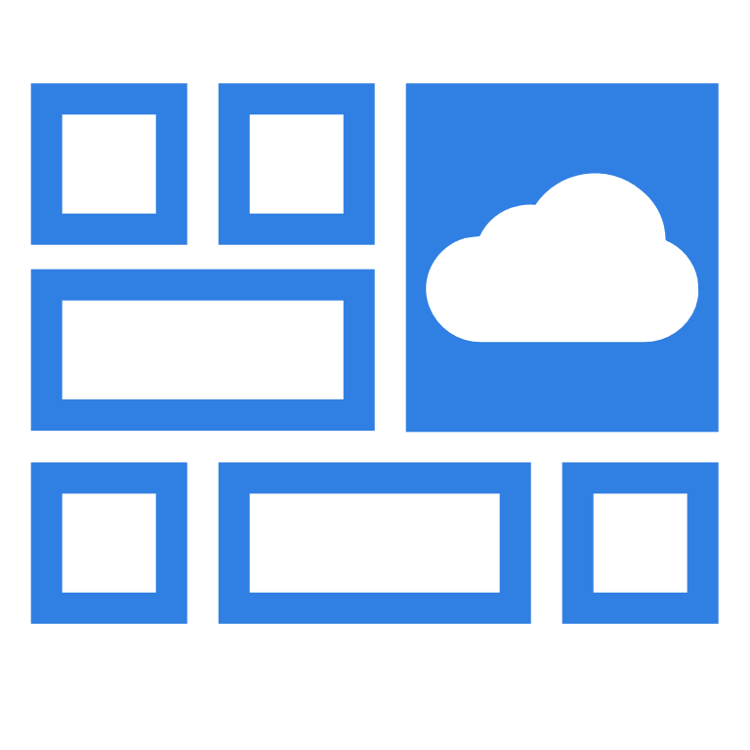







Fortinet Cloud Security Portfolio
FortiWeb
Web applications & APIs
Compliance
FortiGate-VM
Virtual Firewall
Segmentation
Multi-cloud SD-WAN
Cloud Networking
FortiDDOS
• Denial-of-Service protection
DevOps
Web Applications & APIs
SaaS
FortiGSLB Cloud
Load-balancing
FortiCWP
• Cloud workloads & containers
• Cloud security posture
management
FortiMail
Secure inbound email
Outbound threat protections
FortiDevSec
• Application security testing
• DevSecOps
Seamless security securing any applications journey on any cloud
Consistent policies
Deep visibility
Automations through ML / deep-learning
FortiCASB
Manage and secure SaaS applications and data
Notes:
John

Slide 15






















Deliver Enterprise Grade Security Anywhere
FortiGuard Services
FortiOS
VPN
NGFW
Segmentation
SD-WAN
Dynamic Routing
VxLAN
App Control
IDS
Web Filtering
Anti-Malware
Anti-Bot
Anti-Spam
Antivirus
IP Reputation
Cloud delivered Threat Intelligence
Security Services
Networking Services
CPU Cores
Consumption
Network Firewall Leadership in Cloud
Multiple form factors and consumption models for different deployment needs
Broad ecosystem integrations for automation, visibility and enforcement
Consistent Security policies across on-premise, Virtual DC and Cloud
Best Price and Performance for any deployment
FG-VM01
FG-VM02
FG-VM04
FG-VM08
FG-VM16
FG-VM32
Channel
Marketplace
SR-IOV
DPDK
QAT
IPSec-Aggregates
BYOL
PAYG
FG-VMUL
Fortigate-VM
Subscription
Monthly
Network packet acceleration
Scale out or Scale up
Flex-VM
Annual
Public Cloud
Private Cloud or Virtual Datacenter
Virtual Branch

Slide 16


Shared Responsibility and Key Strategies
Responsibility | SaaS | PaaS | IaaS | On-prem
Information and Data
Devices (Mobile and PCs)
Accounts and Identities
Identity and directory infrastructure
Applications
Network Controls
Platform Assessment
Operating system
Physical hosts
Physical network
Physical datacenter
Establish a Modern Perimeter
Modernize Infrastructure Security
“TRUST BUT VERIFY” EACH Cloud Provider
 | Cloud Vendor |  | Customer
Notes:
Every cloud security vendor has a version of this slide. The concept is simple. When it’s your house, you’re in control - and you always know who is responsible for securing it.
But in the cloud, security responsibilities are less obvious.
Each cloud vendor is responsible for physical security and for OS or at least hypervisor level security.
But identity is usually shared – Active Directory in the cloud secured by Microsoft – but it up to the customer to secure those identities and to properly assign and maintain access
Of course, network and platform security is generally up to the customer
And it is always the customer’s responsibility to secure devices, accounts and to ensure that data at rest and in motion is backed up, encrypted and access is controlled.

Slide 17
Broad Protection of the Cloud
B
BYOL
P
PAYG
 | VMWare vSphere | Citrix Xen Server | Xen | KVM | Microsoft Hyper-V | Nutanix AHV | Amazon AWS | Microsoft Azure | Oracle OPC | Google GCP | Aliyun
FortiGate-VM* | ✓ | ✓ | ✓ | ✓ | ✓ | ✓
FortiManager-VM | ✓ | ✓ | ✓ | ✓ | ✓ | ✓
FortiAnalyzer-VM | ✓ | ✓ | ✓ | ✓ | ✓ | ✓
FortiWeb-VM | ✓ | ✓ | ✓ | ✓ | ✓
FortiWeb Manager-VM | ✓
FortiMail-VM | ✓ | ✓ |  | ✓ | ✓ | ✓
FortiAuthenticator-VM | ✓ |  | ✓ | ✓ | ✓
FortiADC-VM | ✓ | ✓ | ✓ | ✓ | ✓ | ✓
FortiVoice-VM | ✓ | ✓ |  | ✓ | ✓
FortiRecorder-VM | ✓ | ✓ |  | ✓ | ✓
FortiSandbox-VM | ✓ |  |  | ✓
FortiSIEM | ✓ |  |  | ✓
FortiProxy-VM | ✓ |  |  | ✓
B
P
B
P
B
B
P
B
P
B
P
B
B
B
B
B
P
B
B
B
B
B
P
B
P
B
B
B
B
B
B
B
B
B
B
P
B
P
P
B
B
B
* Also support AzureStack and RackSpace (PAYG)

Slide 18
Fortinet Cloud Security: Use Cases for Azure

Slide 19

Fortinet Multi-Cloud strategy: 3 principles
Native integration of Security capabilities to each cloud platform (abstracting the cloud specific intricacies and leveraging cloud automation services).
Broad protection of applications offering the broadest set of security products supporting the broadest set of security use-cases across most clouds + protection of all in-house container applications and data (stored in storage buckets etc.).
Central management and automation of all security capabilities across clouds and data centers i.e., FortiMGR + Analyzer + Authenticator

Slide 20
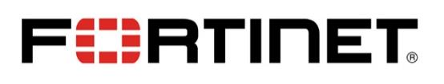

The Fortinet / Microsoft Partnership
Partnering to secure mission critical workloads
Working together to support Enterprise and Government accounts
Sharing a common vision extending security across clouds and data centers with network, application, and platform security.
Business and technical engagements at all levels. Fortinet is the only security vendor on Microsoft’s SAP WW Partner Advisory Board
Business Level Engagement
Deep 2-Way Technical Integrations
Over 10,000 Azure Customers
Microsoft Marketplace Partner of the Year
Top Security ISV Consumption Partner
Fortinet on Microsoft SAP Advisory Board
Fortinet is an Azure top ISV Consumption Partner
Fortinet helps secure Microsoft Technology Centers (MTCs)
Over 101 points of integration including Azure Virtual WAN, Azure Stack, Edgewise, automation technology, Sentinel and more. Meanwhile, Microsoft has achieved “Fabric Ready
Notes:
Fortinet and Microsoft have a long and mutually rewarding relationship.
At the highest level, Microsoft and Fortinet share the objectives in 4 areas:
Our customers are looking to secure data, communications, infrastructure and workloads – where-ever the compute occurs. This is particularly true for mission critical workloads like CRM and ERP systems, financial data, customer information and the like. For example, Fortinet is teaming with Microsoft and SUSE to securely automate the migration of SAP landscapes to the Azure Cloud.
Fortinet works with Microsoft in key verticals where both security and performance are mission critical. This includes engaging with Microsoft in areas like the retail, finance, healthcare and government markets. To this end we are supporting special initiatives like Azure Stack and Edgewise that bring compute closer to the customer. We also integrate into the Azure Security Center and share security data with Azure Sentinel.
This has lead to deep, business level engagement in day-to-day business level support. For example we have over 10,000 Azure Customers, many of whom get our solutions through Azure Marketplace – as a result we are a:
Microsoft Marketplace Partner of the Year
Top Security ISV Consumption Partner
Fortinet on Microsoft SAP Advisory Board
Fortinet is an Azure top ISV Consumption Partner
Fortinet helps secure Microsoft Technology Centers (MTCs)
Finally, both Microsoft and Fortinet have long worked to build a rich array of integrations between our solutions. Fortinet has developed over 96 points of integration between Microsoft and Fortinet solutions. Microsoft, in turn, is a Fortinet Fabric ready partner – which means that Fortinet and Microsoft engineering has worked together to build high performance connectors between the Fortinet security fabric and key Azure security tools like security center and Sentinel

Slide 21
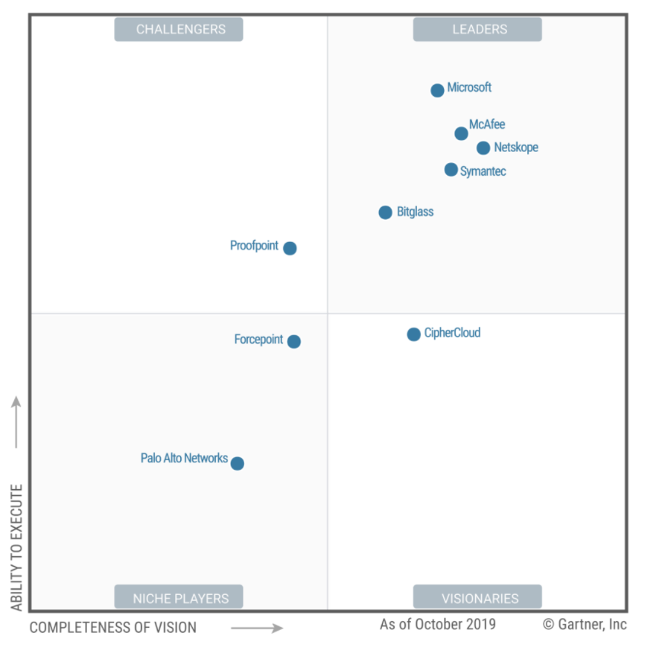
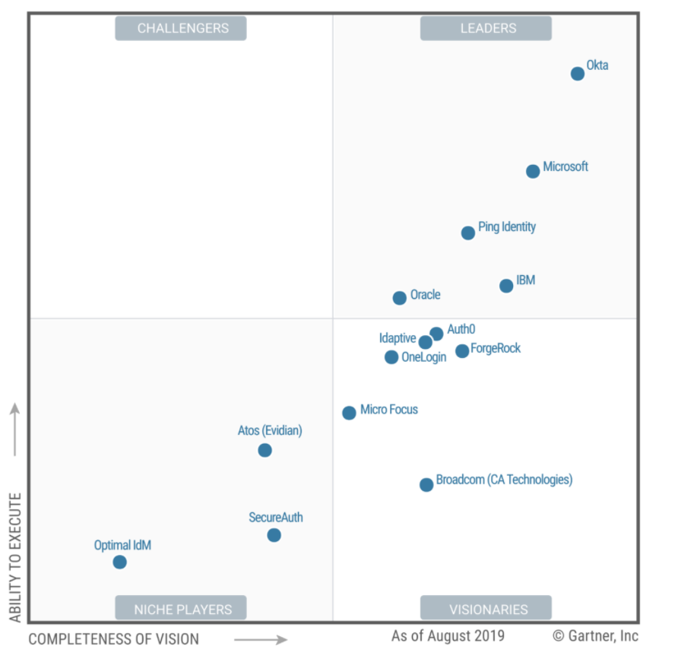
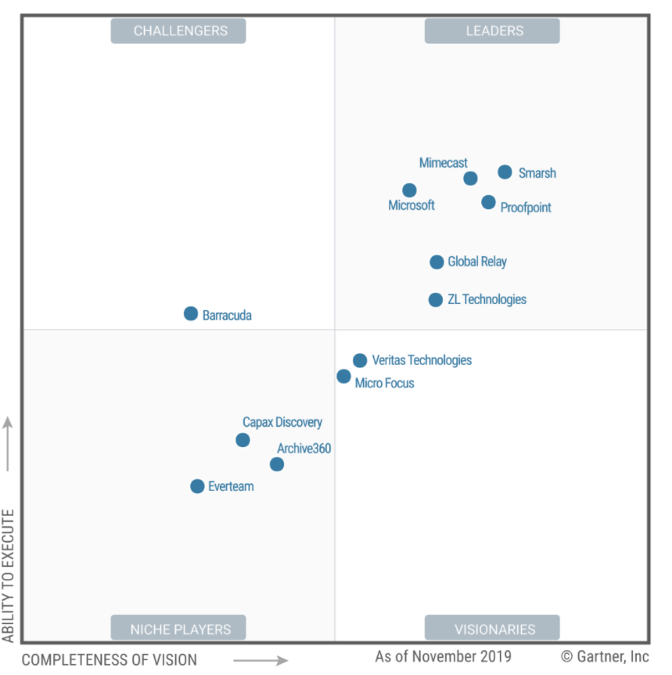
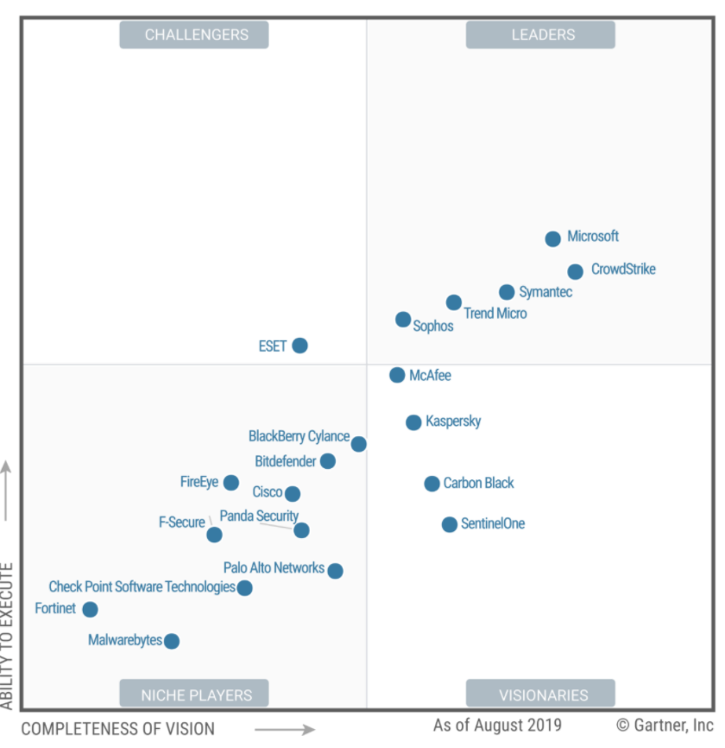
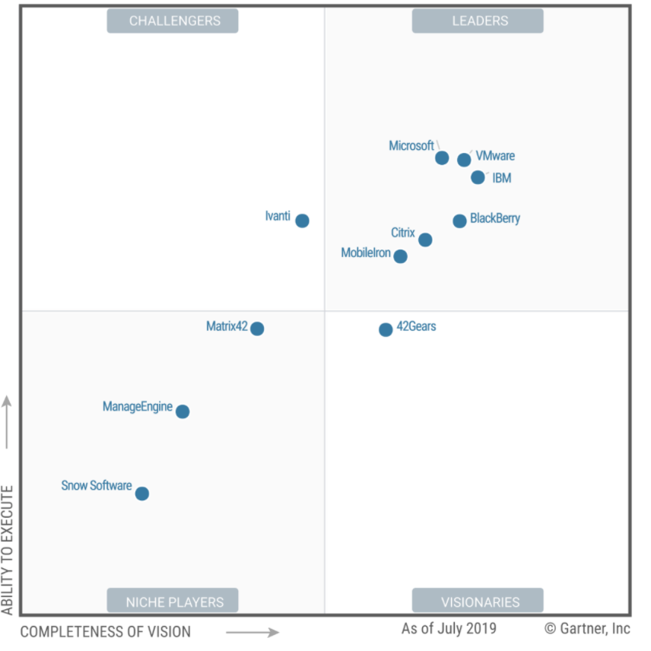
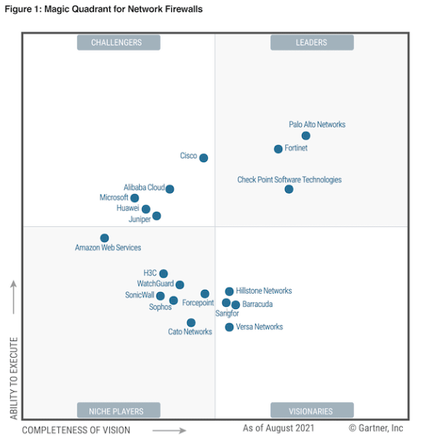
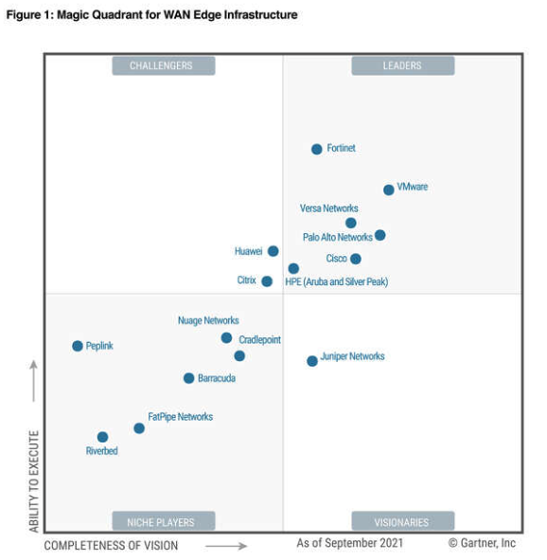
Microsoft - Leader in 5 Magic Quadrants
Cloud Access Security Broker
Access Management
Unified Endpoint Management
Endpoint Protection
Enterprise Information Archiving
Next Generation Firewall
WAN Edge
Fortinet - Leader in 2 different Magic Quadrants
Notes:
Microsoft is leader in 5 MQs
Cloud Access Security Broker (CASB) solutions
Access Management
Enterprise Information Archiving
Unified Endpoint Management (UEM) tools
Endpoint Protection Platforms
We are just present in 1 of these.
NOTES:
Microsoft Security—a Leader in 5 Gartner Magic Quadrants

Slide 22


Winner
Microsoft Partner
of the Year
Azure Commercial Marketplace
Notes:
Fortinet is the Winner of the Microsoft Partner of the Year in the security space!

Slide 23
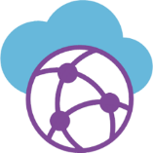




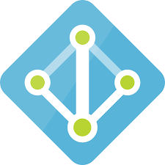
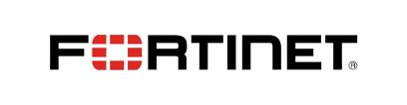


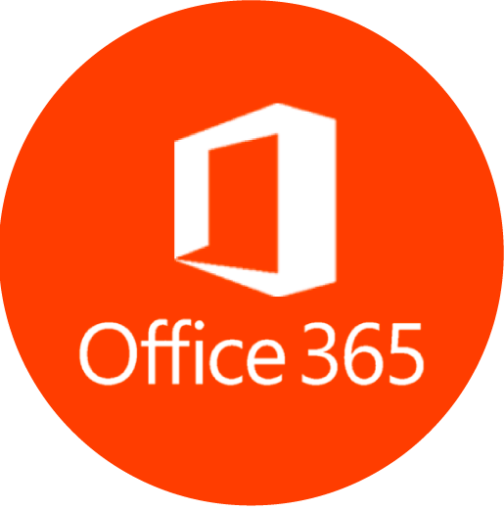

Microsoft Fortinet Partnership
Automation Integration
Microsoft’s Data Center Optimization Program Partner
Microsoft Partner
Of the Year
Azure Top Security ISV Consumption Partner
Connectivity
Scale-Up and Scale-Out Security
Microsoft is Fortinet’s Fabric Ready Partner
Provisioning and Ops
Automation
Platform Security
Azure
Virtual Machines
Azure
Virtual WAN
Response Automation Stitches
Active Directory
Integration
ARM
Templates
Azure Security
Center
Security Alliance Partner
Azure Cloud Functions
Azure Active
Directory
Threat Intelligence
SaaS
Azure Sentinel
Platform Security
Network Security
Application Security
Office 365
Notes:
Fortinet has a long and deep partnership with Microsoft.
On the product side, Fortinet security solutions integrate with key Azure security tools such as Sentinel and the Azure Security Center. Fortinet FortiGate appliances on prem and in branch offices can act as cloud on-ramps into the Azure Virtual WAN – or, for organizations who need more advanced routing and or have greater security needs, FortiGates can be placed within Azure to provide a high security, highly configurable secure connection between data center and cloud.
But back to the partnership.
Fortinet has 17 IP-Co-Sell ready products – which I will cover in a few minutes.
Fortinet is a top security ISV consumption partner
We have over 7000 customers on Azure – including Microsoft itself
Fortinet is an automation partner with a rich array of ARM and Terriform templates, Ansible playbooks, automation stiches, RESTful APIs and more for deep, programmatic provisioning, deployment and management.
We are, of course, a MISA security alliance partner
Microsoft, in turn, is a Fortinet Fabric ready partner – which means that Fortinet and Microsoft engineering has worked together to build high performance connectors between the Fortinet security fabric and Azure
Finally, Fortinet is Microsoft’s Data Center Optimization partner

Slide 24










Key Azure Integrations
Connectivity
Scale-Up and Scale-Out Security
Provisioning and
Automation
Platform Security
Azure
Virtual Machine Scale Sets
Azure
Virtual WAN
Automation
ARM
Templates
Active Directory
Integration
Azure Security
Center
Azure Cloud Functions
Azure Active
Directory
Threat Intelligence/ Security Events
Stack/Stack Edge
&
Edge Zones
Azure Sentinel
Network
Applications
Platform
Azure Stack
Edge

Slide 25
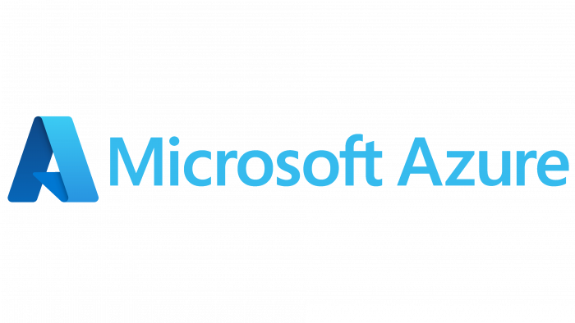

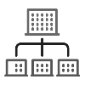

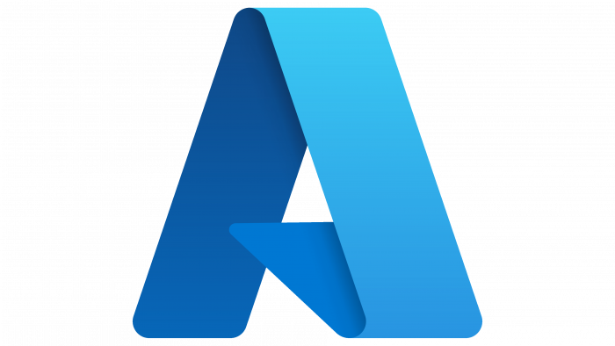







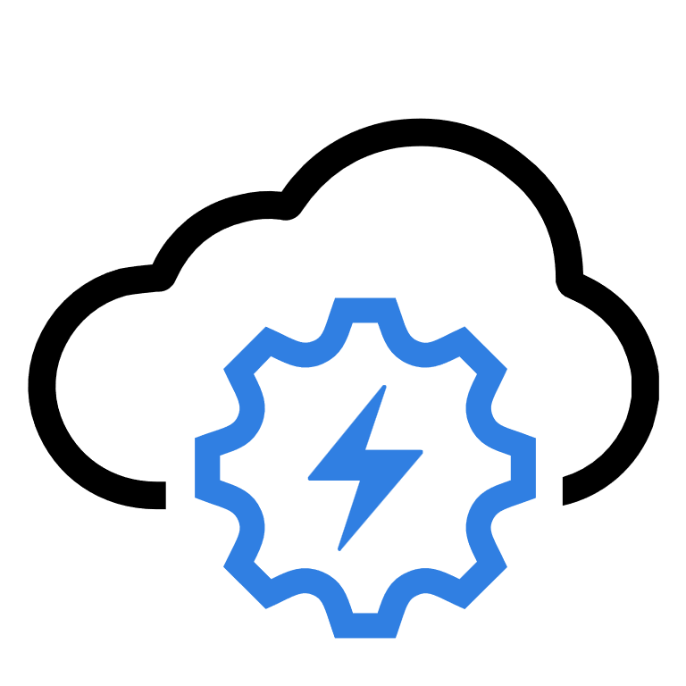
Fortinet Azure Solutions
Cloud Security Services Hub
Express Route
Secure SD-WAN Cloud On-Ramp
Azure Virtual WAN Integration
Hybrid Cloud Security
Web Application Security
Cloud Security Assessment
Secure SaaS Apps
Security at the Edge
Azure
Government
Campus/ Branch Offices
Azure Security Center
Azure Virtual WAN
Azure Stack
Edge
FortiGate
FortiWeb
FortiAnalyzer
Network Watcher
NSG flow events
Instance Profile
Activity Log
Remote Users
Azure Sentinel
FortiMail
FortiSandbox
FortiManager
vNET1
vNET2
Other clouds
Platform
FortiCWP
Notes:
Add Azure Stack Edge
Emph vwan
5G
4 solutons
5G and edge

Slide 26
Partnering with Microsoft
Fortinet and Microsoft working together for security and compliance

Slide 27




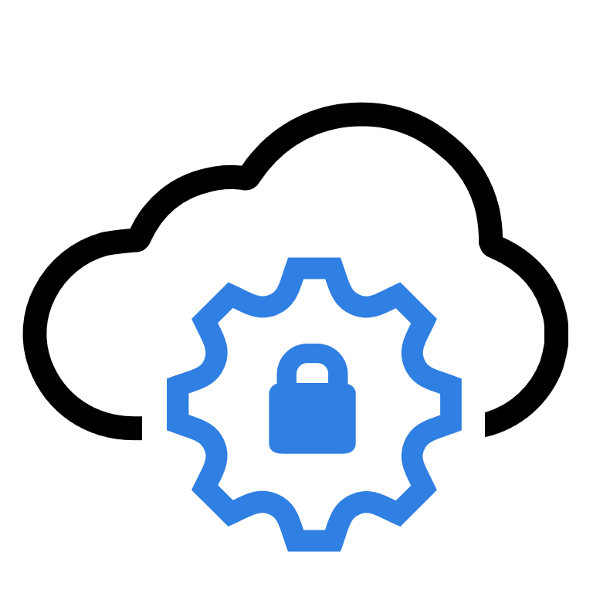

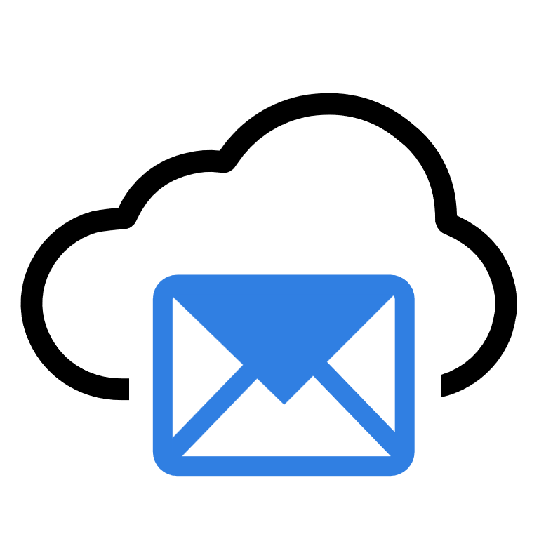

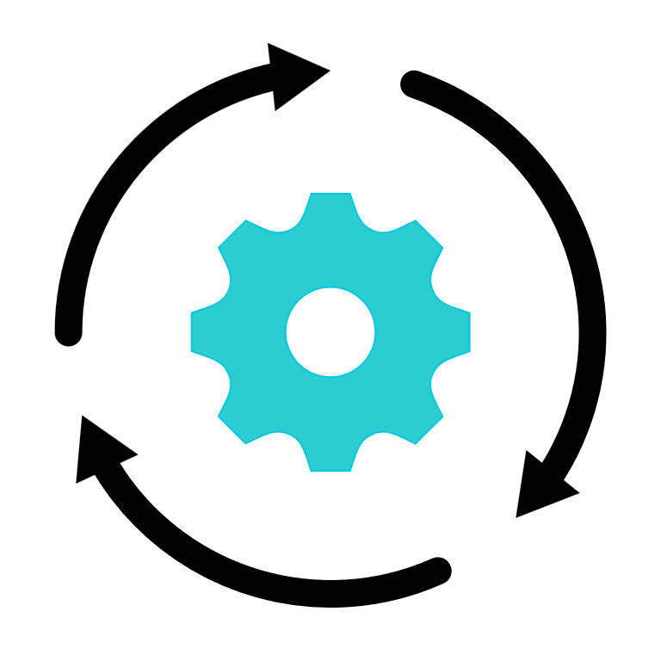

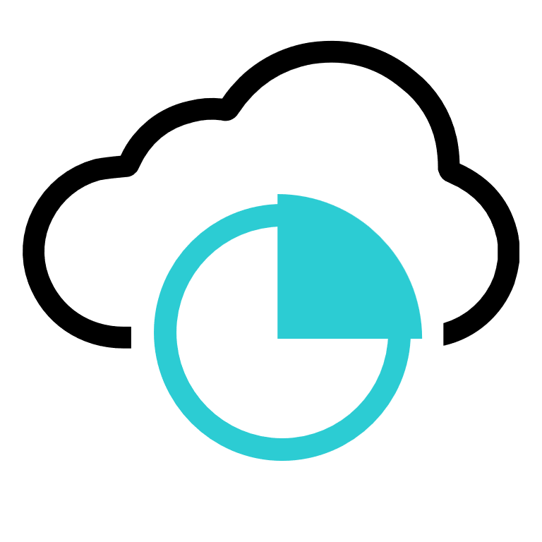


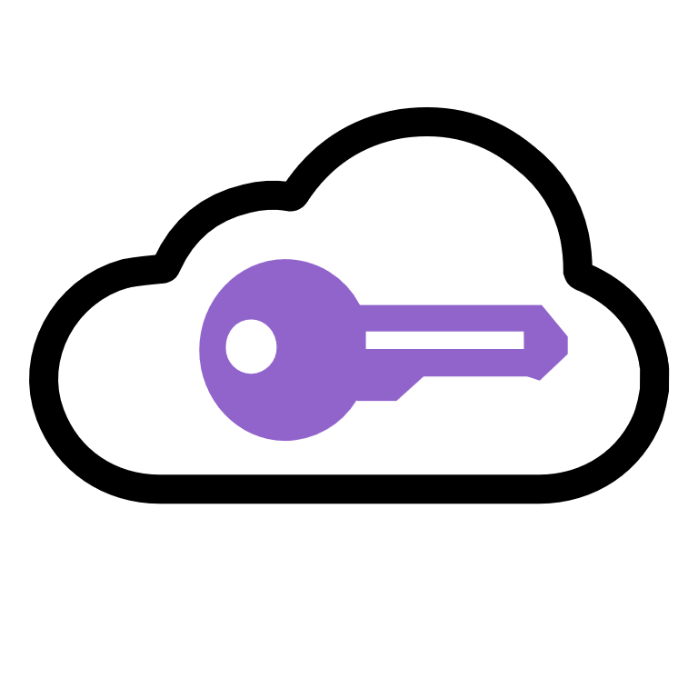
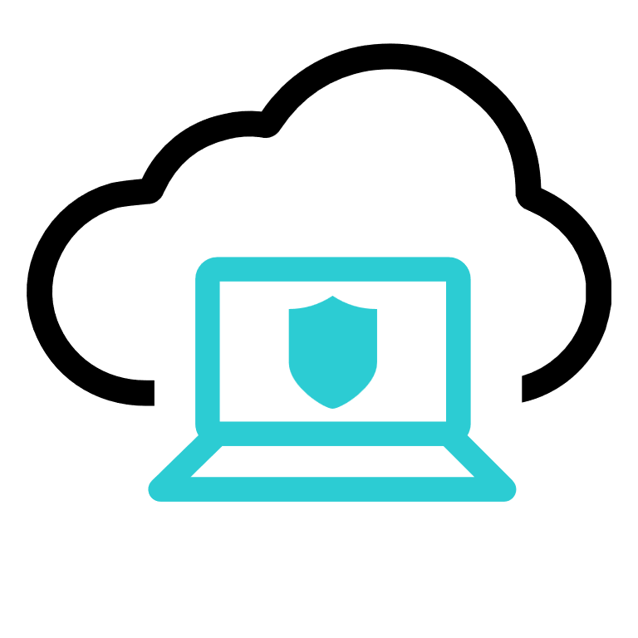
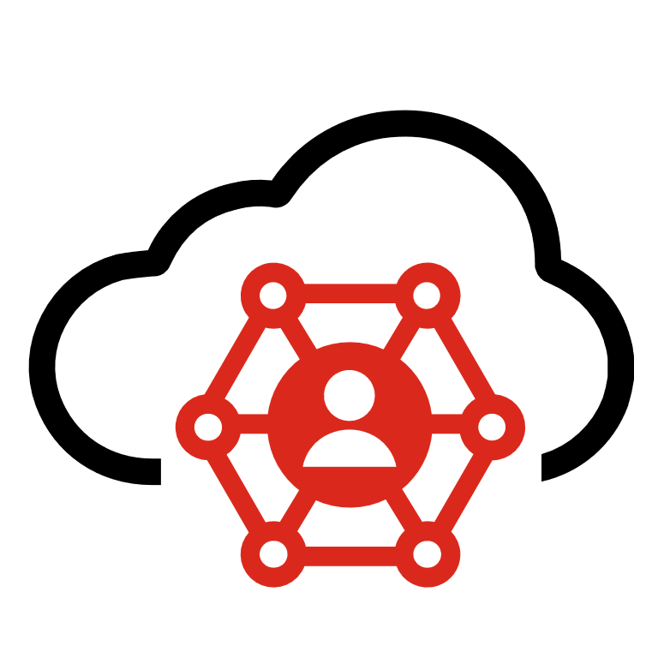



 |  | Azure Active Directory | Azure Sentinel | Azure Cloud Functions | Azure Load Balancer | Azure Virtual WAN | ARM Templates | Azure Kubernetes Services | Azure Stack | Azure Security Center | Express Route | M365 | Windows | Exchange | Teams | Yammer | SharePoint | Outlook | SQL Server | Microsoft CASB | InTune
 | FortiGate | ● | ● | ● | ● | ● | ● | ● | ● | ● | ● |  |  | ● | ● |  |  | ● |  |  | ●
 | FortiProxy | ●
 | FortiWeb | ● | ● |  | ● |  | ● |  | ● | ● |  |  |  | ● |  |  | ● | ●
 | FortCASB | ● | ● |  |  |  |  |  |  |  |  | ● |  | ● | ● | ● | ● | ●
 | FortiCWP | ● | ● |  |  |  | ● | ●
 | FortiADC | ● | ● |  |  |  |  |  |  |  |  |  |  | ●
 | FortiMail | ● | ● |  |  |  |  |  |  |  |  | ● |  |  |  |  |  | ●
 | FortiDDoS | ● |  |  | ●
 | FortiSandbox | ● | ● |  | ● |  |  |  | ●
 | FortiSOAR | ● | ● |  | ● |  |  | ● |  |  |  | ● |  |  | ● |  |  | ● | ● | ● | ●
 | FortiEDR | ● |  |  |  |  |  |  |  |  |  |  | ●
 | FortiAnalyzer | ● | ● |  | ●
 | FortiSIEM | ● | ● |  | ● |  | ● |  |  |  |  |  | ● | ● |  |  | ● |  | ●
 | FortiMonitor | ● | ● |  |  |  |  |  |  |  |  |  | ● | ● | ●
 | Forti-Authenticator | ● | ● |  | ● |  |  |  |  |  |  | ● | ● | ● | ● |  | ●
 | FortiClient | ● |  |  |  |  |  |  |  |  |  |  | ● | ● | ● |  |  | ● | ● |  | ●
 | FortiSASE | ● |  |  |  |  |  |  |  |  |  |  |  |  |  |  |  | ●
 | FortiManager | ● | ● |  | ●
 | FortiDeceptor | ● |  |  |  |  |  |  |  |  |  |  |  |  |  |  |  |  | ●
 | FortiNAC | ● |  |  |  |  |  |  |  |  |  |  |  |  |  |  |  |  |  |  | ●
Fortinet and Microsoft
101 Points of Integration
Notes:
Don’t try to talk to this slide – simply say:
Fortinet has worked hard to integrate our solutions into the Microsoft eco system. I doubt this list is exhaustive – even so, I was able to find 96 points of integration between Fortinet and Microsoft solutions. Let’s take a look at Azure services (next slide)

Slide 28
FortiGates + Transit Gateway Templates
Terraform FGT + TGW & VPC Attachments
https://github.com/fortinet/fortigate-terraform-deploy/tree/main/aws/6.4/transitgwy
Cloudformation FGT + TGW & VPN Attachments
https://docs.fortinet.com/vm/aws/fortigate/6.4/aws-cookbook/6.4.0/614592/deploying-auto-scaling-on-aws-with-transit-gateway-integration
AWS NET402 Video
https://www.youtube.com/watch?v=ar6sLmJ45xs
AWS NET331 Video
https://www.youtube.com/watch?v=yQGxPEGt_-w

Slide 29

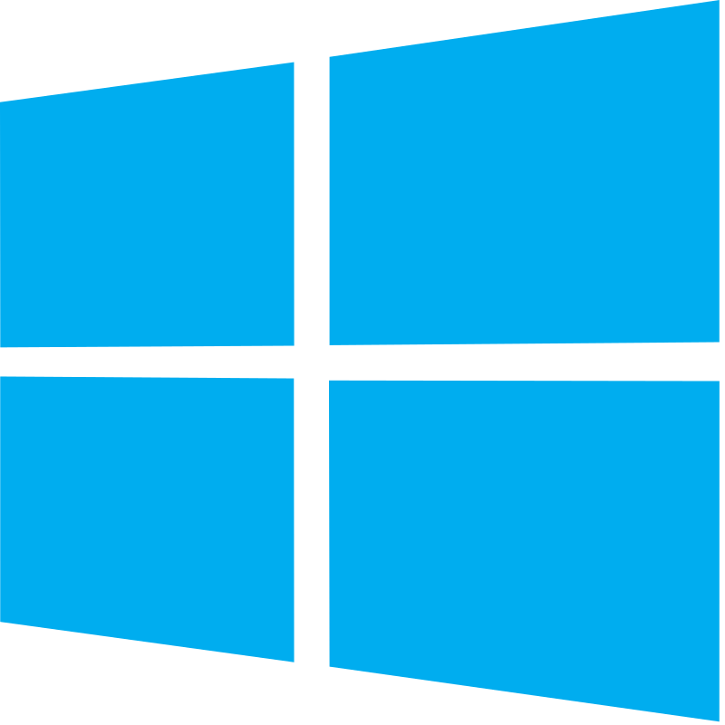








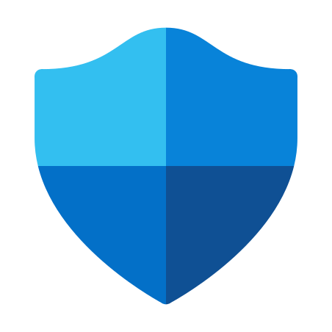



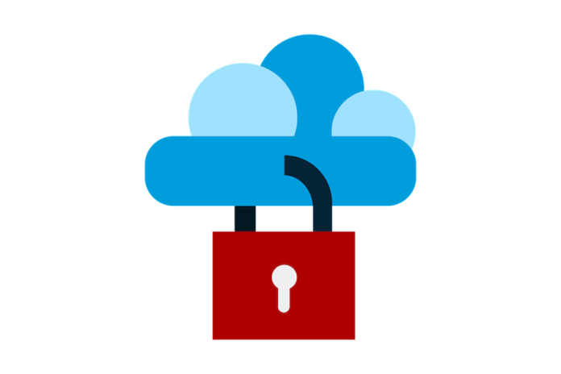



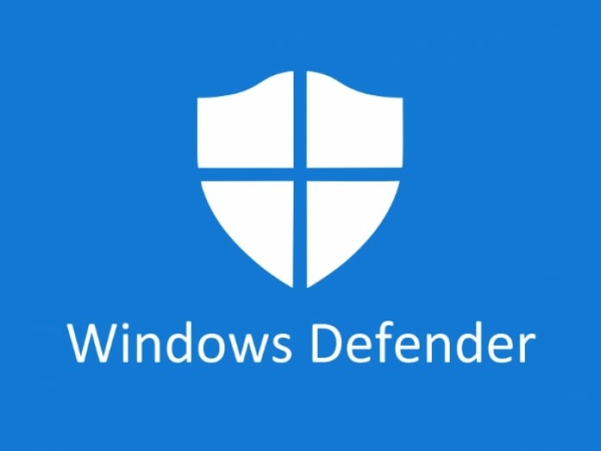
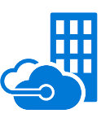







Microsoft Ecosystem in the Enterprise
SaaS
Office 365
Windows
Outlook
Exchange
Yammer
OneDrive
Teams
SOC
Public Cloud
Azure Active
Directory
Azure
Security Center
Azure Front Door
Gateway
Load Balancer
Cosmos DB
Azure Sentinel
Microsoft Defender
XDR
Azure
Virtual WAN
Express Route
VMSS
Azure
Cloud Functions
Azure Kubernetes Services
Microsoft
CSPM
Azure VMware Service
End Point
Virtual
Network
Gateway
Azure Route Server
On-Prem / Private cloud
Windows Defender
Azure Stack
Active Directory
Endpoint Manager
DevOps
ARM
Templates
GitHub
Jenkins
Azure Container Registry
Azure Container Service
Notes:
One way to look at it is to view the Microsoft ecosystem including SaaS solutions, Public Cloud services, private cloud and on-prem solutions, DevOps tools and well as tools for SOC and NOC and endpoint security.
Overlaying where Fortinet sits looks like this
[click]

Slide 30

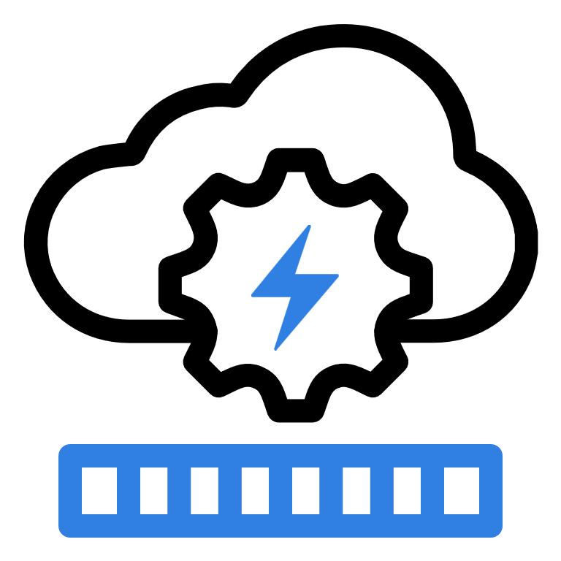


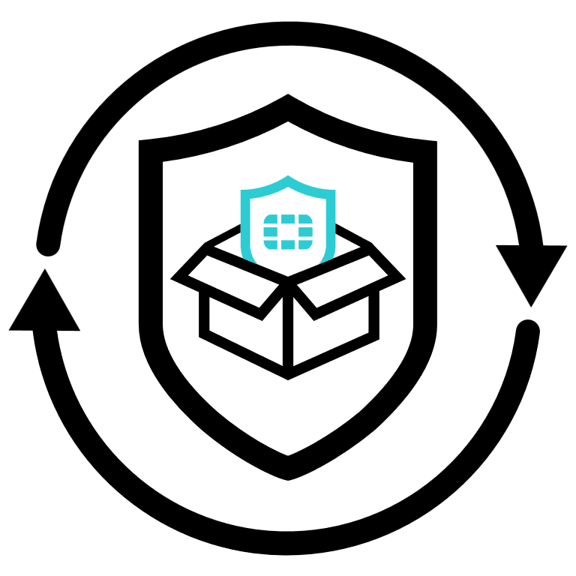


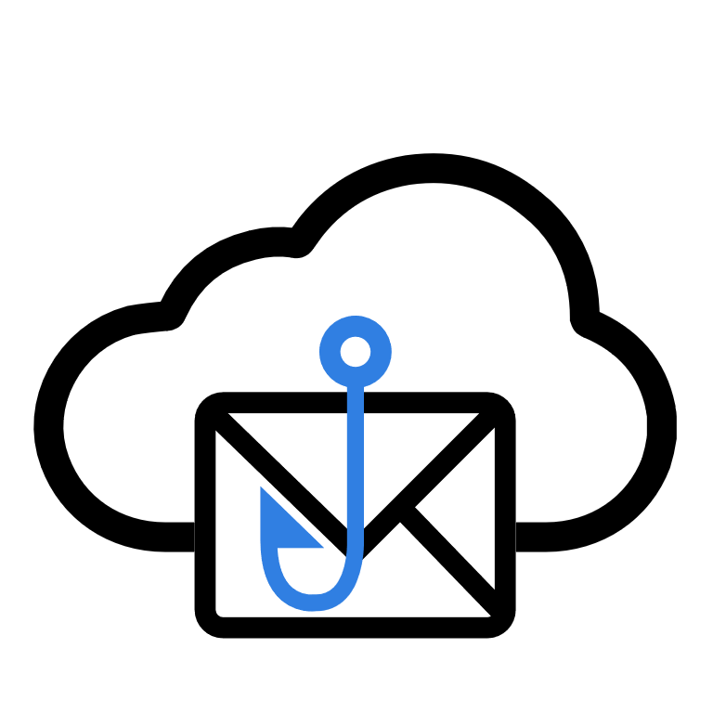


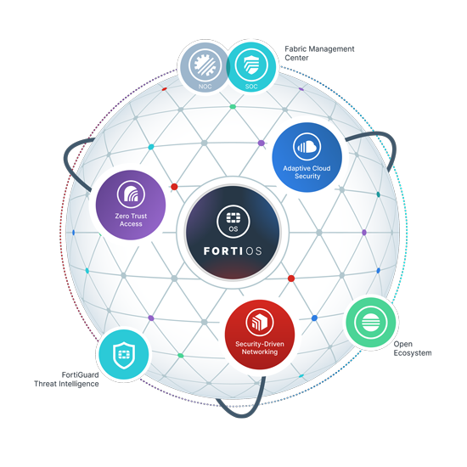

















Microsoft Ecosystem in the Enterprise
SaaS
Cloud Security Services Hub
Public Cloud
FortiGate VM
FortiMail
FortiSIEM
Container Guardian
FortiCASB
FortiMail
FortiSandbox
Forti-Authenticator
FortiCWP
FortiManager
EndPoint
Threat Feeds
Storage Guardian
FortiWeb VM
FortiWeb Cloud
FortiPhish
FortiAnalyzer
FortiEDR
FortiClient ZTNA
Data Center / Private cloud
Security Services
FortiGate
FortiMail
FortiNAC
FortiSIEM
FortiManager
FortiWeb
FortiSandbox
FortiADC
FortiAnalyzer
NOC/SOC
Branch/Campus Network
DevOps
FortiManager
FortiMonitor
FortiAIOps
FortiAP
WiFi
Forti
Switch
Forti
Extender
FortiGate NGFW
ARM
Templates
GitHub
Jenkins
Container Guardian
FortiDevSec
Notes:
Here we see how thoroughly Fortinet secures the Microsoft ecosystem.

Slide 31











Flex-VM Program – Flexible Consumption for all deployments
Any Size
Any Service
Any Environment
Portal Managed
Pay for Usage
VM01
VM02
VM04
VM08
VM16
VM32
VMUL
VM01
VM02
VM04
VM08
VM16
FortiGate-VM
FortiWeb-VM
Scale and Performance
Public or Hybrid Cloud
Security Services
Notes:
Flex-VM is an pre-paid Enterprise License Agreement for Fortinet Virtual Machine licensing Usage can be tracked through the FortiCloud portal with resource consumption calculated using a point-based system.
You can use the Flex-VM portal to create VM configurations, generate licensing tokens, and monitor resource consumption. Flex-VM subscribers can create multiple sets of a single VM entitlement that corresponds to a licensed virtual machine. Each entitlement contains a base VM with the number of vCPUs, and one of four FortiCare and FortiGuard protection services. Resource consumption is based upon predefined points that are calculated on a daily basis .

Slide 32
Flex-VM Program – Flexible Consumption for all deployments
We support
PAYG
BYOL &
Flex VM
VM01
VM02
VM04
VM08
VM16
VM32
VMUL
VM01
VM02
VM04
VM08
VM16
FortiGate-VM
FortiWeb-VM
Scale and Performance
Public or Hybrid Cloud
Security Services
Notes:
Flex-VM is an pre-paid Enterprise License Agreement for Fortinet Virtual Machine licensing Usage can be tracked through the FortiCloud portal with resource consumption calculated using a point-based system.
You can use the Flex-VM portal to create VM configurations, generate licensing tokens, and monitor resource consumption. Flex-VM subscribers can create multiple sets of a single VM entitlement that corresponds to a licensed virtual machine. Each entitlement contains a base VM with the number of vCPUs, and one of four FortiCare and FortiGuard protection services. Resource consumption is based upon predefined points that are calculated on a daily basis .

Slide 33
Fortinet Azure Solutions
Cloud Security Services Hub
Express Route
Secure SD-WAN Cloud On-Ramp
Azure Virtual WAN Integration
Hybrid Cloud Security
Web Application Security
Cloud Security Assessment
Secure SaaS Apps
Security at the Edge
Azure
Government
Campus/ Branch Offices
Azure Security Center
Azure Virtual WAN
Azure Stack
Edge
FortiGate
FortiWeb
FortiAnalyzer
Network Watcher
NSG flow events
Instance Profile
Activity Log
Remote Users
Azure Sentinel
FortiMail
FortiSandbox
FortiManager
vNET1
vNET2
Other clouds
Platform
FortiCWP
Notes:
Add Azure Stack Edge
Emph vwan
5G
4 solutons
5G and edge

Slide 34









Secure Cloud On-Ramp
App Workloads
App Workloads
App Workloads
Network
Connectivity
Center
Multi-cloud SD-WAN
Azure
Virtual WAN
AWS Transit Gateway
Seamless overlay network and consistent security policies for Multi-cloud IT.
FortiGate VM
Enable Multi-Cloud Applications without the Complexity
SD-WAN
Orchestration, Automation, Central Management
Simplify and consolidate cloud network and security
Seamless Multi-cloud SD-WAN network
High performance IPsec
Single pane of glass management simplifies security administration
Consistent Security Posture
Cloud On-Ramp
Multi-Cloud
FortiGate
SD-WAN
SD-WAN
Edge
Datacenter
End to end SD-WAN and security
Cloud-native integration
Notes:
Fortinet offers a Secure SD-WAN for hybrid and multi-cloud solution that efficiently connects and secures applications and data spanning across multiple technologies, cloud regions, edges, and even cloud providers.
Fortinet helps customers operationally simplify their cloud on-ramp and SD-WAN deployment to offer the most secure, seamless, and superior quality of experience. With the broadest deployment and integration options on-premises, at the data center, and across all major cloud platforms, Fortinet Secure SD-WAN can act as the hub to interconnect all your applications across any cloud.
Additionally, we can help simply your SD-WAN operations delivering centralized management and cloud on-ramp orchestration and automation using FortiManager and the Security Fabric. This not only enables ease of deployment but also delivers flexibility and and ease of scale as your digital transformation needs evolves and grows.
At the edge and data center, we offer FortiGate hardware appliances and FortiGate Virtual appliances. In the cloud, we offer FortiGate VM combined with native cloud connectivity integrations like AWS Transit Gateway and Azure Virtual WAN.

Slide 35




Azure Virtual WAN Integration
Azure Virtual Network
Azure Virtual Network
First Converged Secure SD-WAN / NGFW in Azure Virtual WAN
Virtual Network Connections
Virtual WAN Hub Router
A converged NGFW and secure SD-WAN deployed and run natively inside Azure Virtual WAN
BGP
BGP
Enable secure cloud on-ramp from your SD-WAN
FortiGate
Scale Set
Securely extent your SD-WAN into Azure Virtual WAN
Branch to Azure Virtual WAN Connectivity
Secure Branch to Branch Connectivity
Dynamic Path Selection
Custom Application Awareness
Secure and Resilient Office 365 Connectivity
Virtual WAN Hub
Secured SD-WAN Overlay
Branch Location 1
With FortiGate
Manufacturing Location 1
With FortiGate

Slide 36

Key Use Cases
Single Virtual Hub with FortiGate
Azure Virtual Network
Azure Virtual Network
Azure Virtual Network
Azure Virtual Network
East-West Branch to Branch
1
East-West VNet to VNet
6
North-South Branch to VNET
5
2
North-South VNET to Branch
Microsoft.com
Fortinet.com
1
North-South Branch to Internet
2
3
4
3
North-South VNet to Internet
5
4
Virtual WAN Hub 1
Virtual WAN Hub 2
Inter-hub and Hybrid Scenarios with FortiGate
1
2
East-West Branch to Branch
6
4
3
East-West VNet to VNet
North-South Branch to VNET
5
North-South VNET to Branch
Azure ExpressRoute to VNET
Branch Location 2
With FortiGate
6
Branch Location 1
With FortiGate
Branch Location 3
With FortiGate
Branch Location 4
With ExpressRoute
Azure ExpressRoute to SD-WAN

Slide 37






Security for Hybrid Cloud
East-West Virtual Firewall
FortiManager/
FortiAnalyzer
App
DB
Integrated and Automated Security
Web
Web
Advanced North-South and East-West protection, including deep application layer visibility.
Single pane of glass management / Analytics
Innovate Faster without Increasing Risks and Impacting Compliance
Software Defined Datacenter
Protect and mitigate against internal and external threats
Advanced Deep Packet Inspection (L7, IPS, ATP, AV)
Coordinated security controls
Dynamic policy enforcement
Consistent Security Posture on Cloud and On-prem
North-South
Physical Firewall
App Workloads
Internet
FortiGate-VM
WAN
LAN
Azure
Notes:
In Virtual datacenters, FortiGate physical appliance is typically used for securing the Physical network layer. This provides the North-South perimeter protection.
Whereas the FortiGate-VM is used for East-West protection to inspect and provide visibility and control over lateral traffic flows between VM workloads.
Together and with a single pane of management with FortiManager customers can get coordinated visibility and control across the entire virtual DC.

Slide 38









Web Application Security
Internet
Machine Learning Anomaly Detection
Web Application Security
Protect from both Zero Day and OWASP top 10 threats.
Appliance
24/7FortiCare
IP Reputation
ML Optimized Business Application Security
IP Reputation
VM
Web Filtering
Cloud Sandbox
Protects against threats to web-based applications:
Protection against unknown/zero-day threats
Protect against known risks, including the OWASP Top 10
Reduces false positives with machine learning
API Gateway Protection
Virtual Patching
FortiWeb
Antivirus
Cloud
Credential Stuffing
IDS
Container
FortiWeb Security Service
Anti-Bot
Web Application Servers

Slide 39









Cloud Infrastructure Visibility and Control
Cloud Workload Protection
FortiGuard Services
Consolidated multi-cloud visibility into risk posture to identify and protect against threats.
FortiCWP
Consolidated visibility
Data loss prevention
Compliance
Strengthens Security Posture
Public Cloud Management API
Secures multi-cloud workloads:
Discovery and management for cloud workloads, resources and relationships
Container Security
Storage Security – Detects unencrypted storage, malware, and sensitive data
User and Event Behavior Analytics (UEBA)
Compliance Reporting
Anti-malware
Threat detection
Container security
Cloud Network 1
Cloud Network 2
VM
VM
VM
Public-Cloud-Based Infrastructure

Slide 40



















SaaS Visibility and Control
Secure SaaS Usage
Visibility into risk posture for user activities and behaviors, scans for sensitive and malicious files, and prevents data breaches.
Security Governance for SaaS with Confidence
FortiCASB
Secure SaaS Applications:
Centralizes visibility over usage of SaaS applications in a consolidated dashboard
Gives you visibility into traffic, users and data to identify and manage risks
Provides predefined compliance policies for many regulations and compliance standards with on-demand reports for audit tracking
Identifies malware and sensitive data
Consolidated visibility
Data loss prevention
Compliance
Anti-malware
Threat detection
Application security
Remote Users
Notes:
FortiCASB is Fortinet’s cloud access security broker solution – it’ a cloud-based software that sits between cloud service users and cloud applications and monitors and enforces activity and security policies. It monitors SaaS applications for security and compliance. Supported apps include:
AWS S3
Azure Storage
Box
Citrix ShareFile
Confluence
Dropbox Business
Egnyte
Facebook Workplace
Github
Google Cloud Storage
Google Workspace
Jira
Office 365 itself as well apps such as
Microsoft Teams
Microsoft OneDrive
Microsoft SharePoint
Microsoft Yammer
Azure Active Directory
Salesforce
SAP IAS
SAP Success Factors
ServiceNow
Webex Teams
Zendesk
Zoom

Slide 41


High Performance Security at the Edge
Security for Edge Computing
Secure high performance, low latency architectures with Fortinet
Extend Security Fabric to the Cloud Edge
Security Where Networks Meet
Compute & storage is moving closer to the user
Tight integration into Azure Stack Edge and Azure Edge Zones with AT&T (to be announced at MWC)

Slide 42







Internet
FortiGate Service Chaining with Azure Gateway Load Balancer
Consumer Virtual Network 2
Provider Virtual Network
Traffic sent for inspection by FortiGate VM
Traffic sent for inspection by FortiGate VM
Internet
Traffic destined to backend application
Consumer Virtual Network 1
Traffic sent back after inspection by FortiGate VM
Traffic sent back after inspection by FortiGate VM
FortiGate NGFW

Slide 43



Secure Azure VMware Workloads with FortiGate VM
Azure VNET
Public IP
Default Originate
Virtual WAN Hub Router
Public IP
BGP
Virtual Network Connection
BGP
Public IP
Default Originate
Virtual WAN Hub
AVS
ExpressRoute
ExpressRoute
DC

Slide 44



DevSecOps With Fortinet
Container Guardian
Vulnerability management – parses container image formats and detect the existence of vulnerable libraries inside a container image
CI/CD integration – integrates natively with CI tool (such as Jenkins) for both vulnerability detection and build management
Scan all nodes in the cluster for Kubernetes CIS benchmark compliance
Alert and/or block container deployment if non compliant
Container Guardian
Configure to fail build with certain CVEs (e.g. critical vulnerabilities)
Non compliant
compliant
FortiDevSec
FortiGate
Deploy
K8S Network Security with Calico & FortiGate
GitHub
AKS

Slide 45
The Fortinet Advantage
You don’t have to Settle for “Good Enough” Security

Slide 46
10,000+
Employees
58.2B Market Cap (as of 12.31.21)
Nasdaq: FTNT
Global Coverage
S&P 500
Who is Fortinet?
600,000+
Customers Worldwide
50+
Integrated Fabric Products
For over 20 years, Fortinet has been a driving force in the evolution of cybersecurity and the convergence of networking and security. Our network security solutions are the most deployed, most patented, and among the most validated in the industry.
Massive Customer Input
Broadest Attack Coverage
1,000+ Zero Day Discoveries
WEF C4C Cybersecurity Founders
1,250
Patents Globally
Advanced Threat Research
Top Innovator
7M+
Global Firewall Shipments
World Leader in Firewalls Shipped

Slide 47



The Fortinet Advantage – Automated Micro-Segmentation
Micro-segmentation
Secure Network Design
Micro-segmentation
N/S or E/W traffic
Isolate sensitive workloads
Prevents breach transversal
Zero
TRUST
Zero Trust Architecture
SAP Integration/Automation
Automated and Monitored
Leverages User Defined Routes (Azure) and Automation stitches
Forces network traffic through a FortiGate for inspection and policy enforcement
Separates systems/hosts into subsets
Azure Virtual WAN Integration

Slide 48

The Fortinet Advantage – SAP Integration
Micro-segmentation
Secure Network Design
Extensive SAP integrations
Tested reference architectures
NGFW, WAF, IPS, Endpoint, SAP Honeypots, SAP specific threat intelligence
Zero
TRUST
Zero Trust Architecture
SAP Integration/Automation
Automated and Monitored
SUSE SAP automation integration
Automation Templates
SAP traffic visibility
SSLi with extensive threat detection
Centralized security analytics
Reference architectures
Azure Virtual WAN Integration
Learn more about securing SAP

Slide 49
The Fortinet Advantage – Azure Virtual WAN Integration
Only dual-role SD-WAN and NGFW integrated natively with the Azure Virtual WAN hub
Micro-segmentation
Secure Network Design
Branch to Azure Virtual WAN Connectivity
Secure Cloud-on Ramp
Secure Branch to Branch Connectivity
ExpressRoute Support
Zero
TRUST
Zero Trust Architecture
SAP Integration/Automation
Automated and Monitored
One-touch configuration
Automatically peer via BGP with the Virtual WAN hub router
Can be deployed from the Azure portal or from Azure Marketplace
Azure Virtual WAN Integration

Slide 50
The Fortinet Advantage – Zero Trust Architectures
Unifies Zero Trust, Network and Endpoint Security
Secure Design
Endpoint and network access control
Role-based, granular access control with application awareness
Ongoing verification
Automatic encrypted tunnels
Threat and vulnerability scanning
Micro-segmentation
Zero
TRUST
Zero Trust Architecture
SAP Integration/Automation
Endpoint, Network, and Application Access Control
Identify, profile, and scan all devices for vulnerabilities
Establish and ensure ongoing network control
Establish and enforce policies that limit network access to only what is needed
Create a secure, automatic connection between the user and ZTNA proxy point
Maintain automated response and network orchestration
Azure Virtual WAN Integration

Slide 51

Why Customers Choose Fortinet
Fortinet has the world’s broadest security product line
The Fortinet Security Fabric weaves together clouds and data center security
Fortinet is the leader in network security – a position validated by analysts and security tests
Advanced automation tools
Tested deployment guides and reference architectures
World class threat research from FortiGuard Labs

Slide 52
Securing SAP Migrations to Azure

Slide 53








Notes:
I’m not saying that SAP systems are insecure – at least no more insecure than software from Microsoft or Oracle or IBM or anyone else for that matter.
But when and SAP system is breached – it’s a big deal. As I said, SAP represents the crown jewels of corporate information – and a security breach can have dire consequences including the loss of customer information, financials, product and road map information, sales and marketing plans, confidential employee information … the list goes on and on.

Slide 54
Why SAP Security is important
SAP Admins do not maintain Network Security
Network Admins do not maintain SAP Security
Nobody secures the SAP Systems

Slide 55
Why discuss SAP S/4HANA now?
SAP will end support for older solutions by 2027
Most S/4HANA deployments will be cloud-based
SAP is a natural target for cyber-attack
Fortinet has created SAP specific security integrations
Fortinet has worked with Microsoft and SUSE to secure
SAP on Azure

Slide 56


Fortinet Security Fabric SAP Integration
Commitment to Securing SAP
SAP and Java specific threat signatures
FortiADC SAP Connector
FortiPenTest SAP exploit modules
FortiDeceptor
SAP Honeypot
FortiCASB SAP IAS / SuccessFactors integration
FortiSOAR SAP integration
Platform Security
Network Security
Application Security
Notes:
FortiSOAR as an example aggregates and enriches alerts from a wide range of security products to enable rapid response and automated alert triage. Enhanced SOAR products embed easily within your security landscape. They use security “playbooks” to automate and coordinate workflows that may include any number of disparate security tools as well as human tasks.
A series of actions conducted by an account and/or terminal in SAP NetWeaver may trigger a detection pattern to execute an automated action within your SOC.
Center Optimization partner

Slide 57







Fortinet Cloud Reference Architectures for SAP
Return to Presentation

Slide 58

Secure SAP on Azure
Fortinet Reference Architecture
FortiGate NGFW
  frontends SAP traffic supporting VPN termination
  forwards SAP NI traffic to SAProuter from worldwide SAP Support Centers
  segments SAP landscapes within Hub
  provides E-W & N-S inspection within Hub
FortiADC
  Replaces SAP Web Dispatcher
  WAF to Secure SAP Fiori
  API Security for SAP Systems

Slide 59

Notes:
Highly complex deployment
Multiple SAP System Landscapes
Using dedicated transit vNet per SAP System Landscape for East/West segmentation between SAP System Landscapes and between SAP Systems within SAP System Landscape
FortiGate for perimeter FW
HA Cluster
Egress Webfilter, DDoS protection, etc
Each transit vNet:
FortiGate for segmentation
HA Cluster, autoscale could be necessary
Intrusion Prevention, Application Control, etc
FortiADC for Webprotection
Using dedicated SAP Connector for Loabalancing and automation
Active-Active deployment (VRRP)
Web Application Firewall
SAP API protection

Slide 60

Secure SAP on GCP
Fortinet Reference Architecture
FortiGate NGFW
  frontends SAP traffic supporting VPN termination
  forwards SAP NI traffic to SAP router from worldwide SAP Support Centers
  segments SAP landscapes within Hub
  provides E-W & N-S inspection within Hub
FortiADC
  Replaces SAP Web Dispatcher
  WAF to Secure SAP Fiori
  API Security for SAP Systems

Slide 61

Notes:
To provide east-west segmentation
setup VPN gateway per Spoke VPC
Connect VPN Gateways to FortiGate for peering
Route traffic from spokes to Hub VPC via VPN for inspection and segmentation

Slide 62

Notes:
Alternative solution to VPC peerng via VPN – using AWS Transit Gateway.

