Slide 1
Grants Support Program Bringing Technology Funding Home for Public Sector Agencies

Slide 2
Fortinet Grant Support Program Fortinet and our partners are now offering a comprehensive grant support program. This FREE program provides public sector agencies with grant information, customized research, and consultation services that help develop project ideas, identify available grant funding for technology-rich projects, and even expand initiatives that are already in the works.

Slide 3
About Grants Office, LLC
Grants Office is a global full-service provider of grant research, consultation, and administration services that offer expertise on available or upcoming funding via various government and private resources.
Grants Office has a 20+ year track record of finding and securing funding for clients across the globe.
2021 Track record
67% grant award success rate for SLED customers
$1.2 Billion in Grant Funds awarded

Slide 4
Top Grant Recipients
Public and Nonprofit Private K-12 Schools
Colleges and Universities
Libraries and Museums
Early Childhood or Special Education Service Providers
Workforce Dev. Agencies
Other Nonprofit Edu. Organizations
Regional or Municipal Agencies
First Responder Groups
Law Enforcement, Courts and Corrections
Transportation Departments
Housing Authorities
Tribal Organizations
Teaching Hospitals and Medical Schools
Non-profit Hospitals and Clinics
Federally Qualified Health Centers
Rural Health Clinics
Research Institutions
Mental and Public Health Agencies
Education
State & Local Govt
Healthcare

Slide 5
Grants Support Program Services
Funder Prospecting
Grant Readiness Coaching
Project-Specific Consultation
Proposal Development Assistance

Slide 6
Examples of Projects Grants Fund
K-12 Education | Healthcare | Higher Education | State & Local Gov
Response to COVID-19 pandemic
1:1 student to device initiatives or remote/virtual education | Remote patient management & Telehealth | Career readiness | Broadband connectivity
Student data analytics & Learning management | Rural or Underserved community health | Workforce development & Apprenticeship Training | Telework for government staff & Virtual government
STEM & Literacy initiatives | Patient check-in, Assessment/Triage | Innovative undergraduate education methods | Emergency preparedness & Response
Extended learning time programs | Emergency medical response | Infrastructure supporting faculty research | Public safety mobility
Teacher professional development | Cost of Care Reduction | Underrepresented student retention & success | Improved Justice & Corrections
College & Career Readiness | Medication management | Individual research projects | Transit infrastructure & Intelligent systems
School safety | Health Professional education & training | Campus safety | Election security

Slide 7
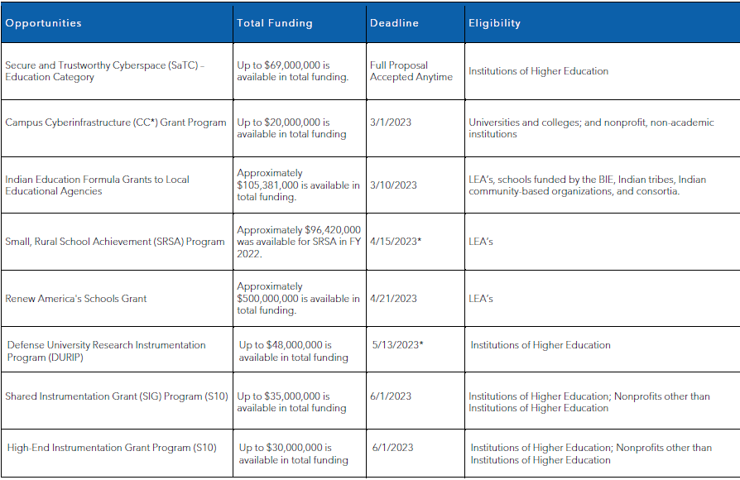
Example of Grants for Higher ED

Slide 8
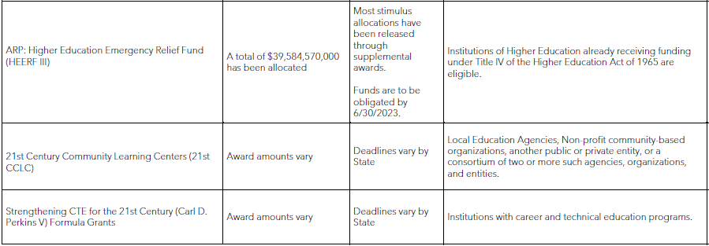
Example of Grants for Higher ED

Slide 9
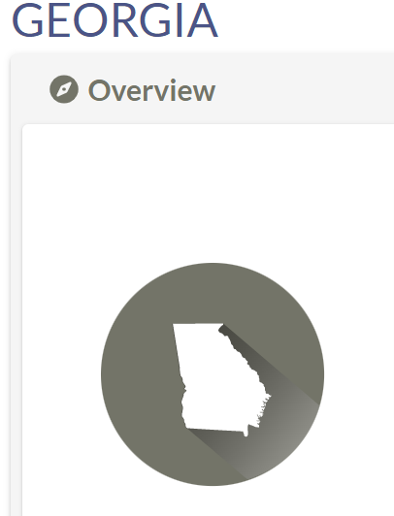
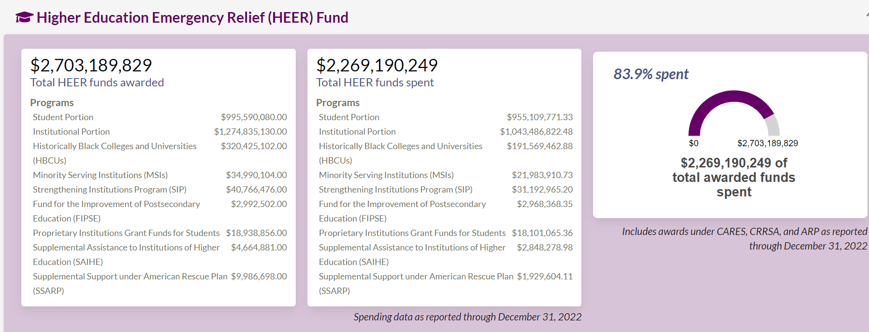
HEERF Time Clock is Counting down

Slide 10
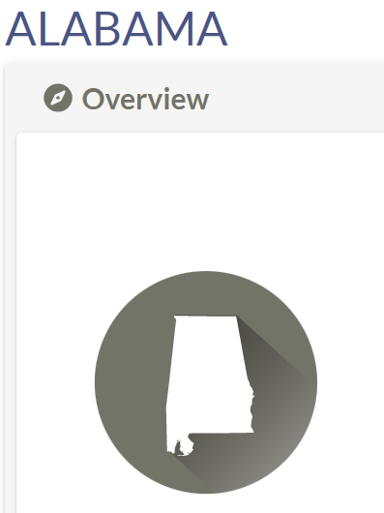
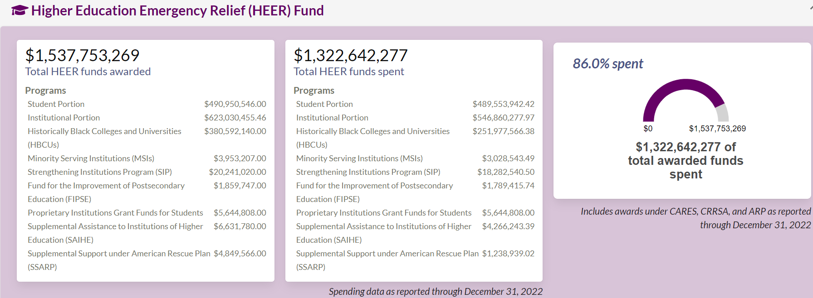
HEERF Time Clock is Counting down

Slide 11
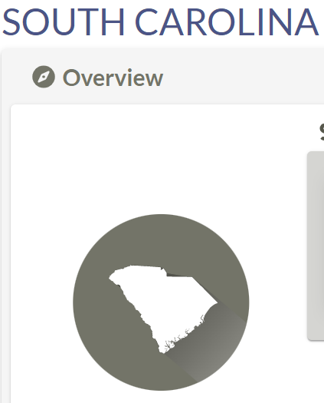
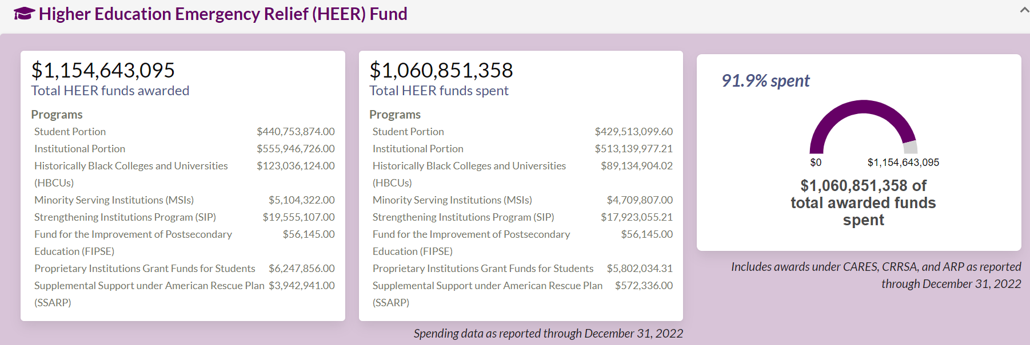
HEERF Time Clock is Counting down

Slide 12
Pilot Success Story
Initial Interest:
$200-$300K in desired Fortinet and Microsoft solutions to refresh current infrastructure.
Support Services Provided:
Aided in determining which among the desired NJ Educational Facilities Authority grants would be most appropriate to pursue.
Project development consultation.
Proposal preparation coaching.
Result:
Project budget grew to include nearly $2M in Fortinet solutions.
Grant has been submitted and is pending award decision.
Notes:
Farleigh Dickinson University

Slide 13
Questions?
Notes:
Instructions:
-Please replace the placeholders

