Slide 1
Securing Critical Infrastructure and Hybrid Cloud
How SafePC Solutions, Microsoft and Fortinet can help

Slide 2
Agenda
Introducing SafePC Solutions
Cybersecurity for Higher Education
Digital Transformation
Common Threats and Advanced Threats
Security Modernization
What is a Security Roadmap?
Microsoft Security Training
Sign Up for a Complimentary Security Assessment
Q&A Session
2

Slide 3
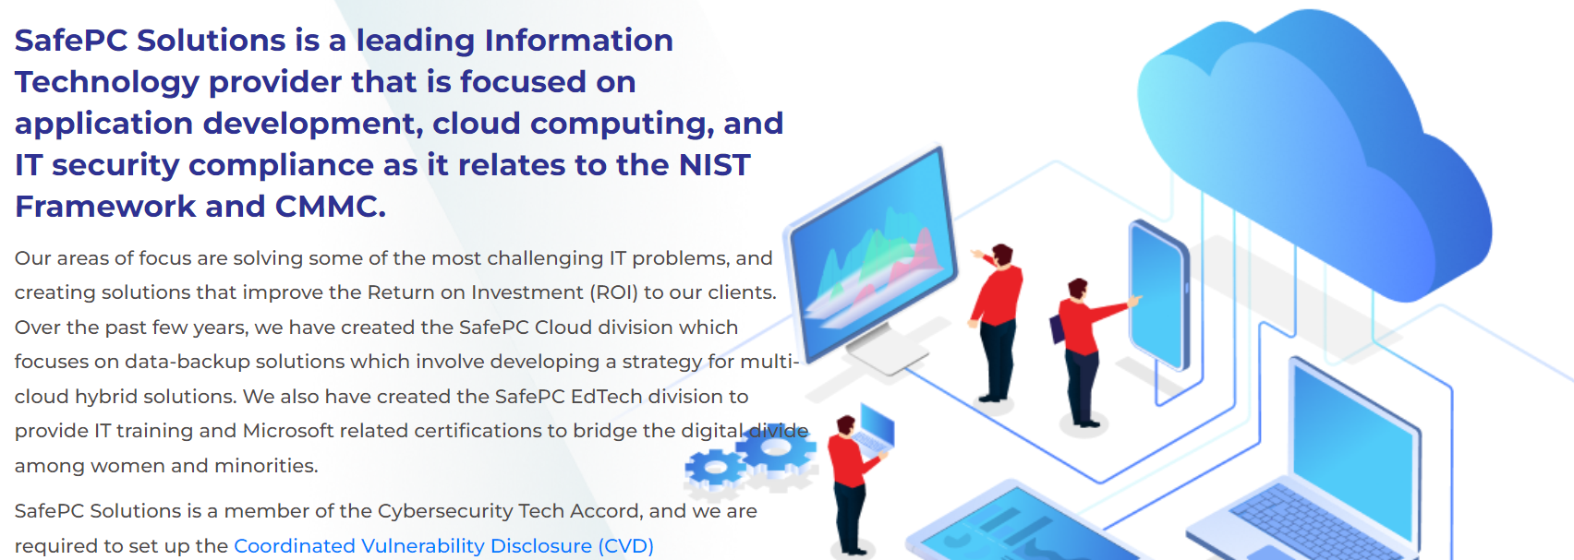
Who We Are

Slide 4
Our Core Services
MICROSOFT CLOUD SOLUTION PROVIDER (CSP)
DIGITAL TRANSFORMATION
DATA BACKUP AND BUSINESS CONTINUITY PLANNING
CMMC & NIST FRAMEWORK COMPLIANCE INCLUDING VULNERABILITY MANAGEMENT
NETWORK SECURITY SOLUTIONS
IDENTITY ASSESS MANAGEMENT
WORKFORCE DEVELOPMENT

Slide 5
Our Partners
Microsoft
Fortinet
OpenText/Carbonite
Synology
InfoSec
Pax8/AWS
Google
Certiport

Slide 6
Closing the Cyber Skills Gap
AI
TECHNOLOGY
Digital Transformation
* Gartner, Establish an Effective IT Skills inventory to Assess Workforce Capability Gaps
87% of enterprise IT/security pros agree skills gap has or will impact their organization²
IoT
BYOD
Decreasing skills half-life
Required # of job skills has increased 6.3% YoY since 2018
>50% of skills needed in the average job are new*
Cloud Computing
Virtualization
Mobile
PACE OF LEARNING
¹ Gartner, Establish an Effective IT Skills inventory to Assess Workforce Capability Gaps
² Infosec 2019 Cybersecurity Skills Gap survey
Notes:
Reason for being
While Infosec Skills launched in 2019, we’ve provided IT and certification boot camps for over 17 years. And we’ve learned a lot along the way when it comes to cyber training and teams. Most notably that traditional, theory-based cyber education and certification programs are not enough to upskill our workforce or prepare new talent for any of the 4 million+ open cyber roles worldwide. New and increasingly sophisticated cyber threats demand a new approach to cyber upskilling and reskilling that keeps up with the rapid pace of technology change. While certifications have been and will continue to be important, they are likely not the best resource to help learners keep up with the rapid pace of technology change. We knew cybersecurity professionals needed easy access to more trusted, role-guided and hands-on training than just the occasional certification boot camp provided.
Infosec Skills addresses this need head-on with role-based training recommendations that takes learners from theory to practice with over 1,400 courses, hundreds of hands-on labs and assessments.
—-------------
Market trends details:
The “half-life” of skills is decreasing. The total number of skills required for a single job has increased by 6.3% YoY since 2018, and over half of the skills needed in the average job are new. - Gartner, Establish an Effective IT Skills inventory to Assess Workforce Capability Gaps
78% of those who have recently resigned or plan to resign from their job are pursuing online training courses or certificate pros, and 64% said these courses were essential to landing a new job. - Cengage Group Research, From the Great Resignation to the Great Reskilling
By 2025, 30% of global orgs wil use microcredentials to calibrate skills, reward upskilling and match talent to increase productivity - Gartner, Microcredentials Promote Continuous Learning & Build an Agile Workforce
gram
By the end of 2022, more than 80% of higher education institutions will issue some form of digital credential. - Gartner, A Simple Higher Education 'Business Opportunity' Framework for Continuous Learning
By 2026, at least 60% of universities globally will supplement degree education with industry co-created credentials to support student employability. - Gartner, Predicts 2022: Education — Review, Refocus, Rebuild
Currently, 3.5M unfilled cybersec positions globally - Cybersecurity Ventures
With nearly 600K open positions in US alone - CyberSeek, Burning Glass
Example Infosec Skills HiEd clients: Penn State, North Dakota State, Marquette Univ, Allen Univ,

Slide 7
Future of HBCU & Technical Community College Transformation
Secure IT Infrastructure
Educating Staff and Students on Cybersecurity Awareness
Ensuring IT Staff achieve more robust training in Cybersecurity
Building a Long-Term Secure Roadmap to protect the growth of on-line training programs, certification programs, and research development initiatives

Slide 8
Featured Client
Ebenum Equation, Leadership Development Firm in Higher Education, Enterprise Corporations, and Government
Ebony Smith, President & CEO
Faculty Member and Fellow, Florida International University ‘s Center for Leadership
CMMC/NIST Framework Compliance
Microsoft 365 E5
OpenText/Carbonite
FortiSase-Cloud based Secure Network

Slide 9
Cybersecurity Threat Assessment Program
Rick Harrison
Senior Network Administrator/System Engineer

Slide 10
Next-Generation Firewall –Network Assessment
NGFWNGFW (Firewall) Risk Assessment
Join SafePC and Fortinet for a free in-depth report
NGFW (Firewall) Risk Assessment
NGFW (Firewall) Risk Assessment
Executive Summary
We aggregated key findings from our HGFW assessment within the Executive Summary Below. While the highlights are listed below, a more detailed view of each section follows. Be sure to review the Recommended Actions page at the end of this report for actionable steps your organization can take to mitigate inbound threats, implement corporate use policies, and avert capacity planning issues.
Gain insights and aggregated metrics across:
Security
Productivity
Utilization
Recommendations
Security
11,126
Application Vulnerability Attacks Detected
13
Malware and/or Botnets Discovered
17
High Risk Applications Detected
Note that any threats observed within this report have effectively bypassed your existing network security gateway, so they should be considered active and may lead to increased risk (such as a data breach)
Productivity
330
Total Applications Detected
5
Total Proxy Applications Detected
5
Total Peer to Peer Applications
Applications usage should have a strong influence on your network architecture. Understanding which types of applications are being used can affect corporate use polices, controls on segmented networks, and utilization of cloud-based service platforms.
Utilization
40.5GB
Total Bandwidth Used
12.5
Average Log Rate per Second
58.0%
Percentage of SSL Encrypted Traffic
36
In addition to individual applications, understanding overall utilization can help with capacity planning and streamlining network traffic over time.

Slide 11
Email Security Risk Assessment
gn Up: Complimentary Email Risk Assessment
Join SafePC and Fortinet for a free in-depth report
Email Risk Assessment
NGFW (Firewall) Risk Assessment
Executive Summary
We aggregated key findings from our email risk assessment with the Executive Summary below. As represented in the summary, this report is divided into three sections: Security, Productivity, and Utilization. While the highlights are listed below, a more detailed view of each section follows. Be sure to review the Recommended Actions page at the end of this report as well for actionable steps your organization can take to mitigate email borne threats and optimize your overall email experience
Gain insights and aggregated metrics across:
Security
Productivity
Utilization
Recommendations
Security
842
Know or Suspected Attachment-based Attacks
52
Know or Suspected URL-based Attacks
4
Known or Suspected Impersonation-based Threats
Note that any threats observed within this report have bypassed your existing email security solution, so that should be considered active and potentially dangerous
Productivity
415, 225
Emails Flagged as Spam
19,925
Suspected Newsletters
1,647
Emails Detected with Adult Content
Although not necessarily malicious span, newsletters and/or emails with adult content represent a potential nuisance and/or offense. Organizations should consider whether the current level of unwanted or inappropriate email is acceptable.
Utilization
15,215
Average Emails Processed Per Day
1.6GB
Average Email Bandwidth Per Day
110.6KB
Average Email Size
Although you may have moved to cloud-based email infrastructure, utilization statistics can be valuable in a number of ways, they can be used to compare your email utilization against industry norms. Daily usage numbers can be tracked over time; deviations analysis is also helpful when determining anomalous company-wide behavior.
37

Slide 12
Securing Critical Infrastructure and Hybrid Cloud
Cybersecurity for Higher Education

Slide 13
Today’s Presenters
y’s Presenters
Madinah Ali
SafePC Solutions
CEO & Founder
Corey J. Lee
Microsoft
Zero Trust Architect
at Microsoft for
US Education
Mike Lauer
Fortinet
Director – State and Local Education Capture Programs
T.J. Sapp
Fortinet
Public Cloud Regional Manager
10

Slide 14
Cybersecurity is a major concern concern for Higher Ed
Higher Ed
Higher Ed faces greater risks at a higher frequency than most organizations
63%
5.8M+
90%
41%
Of all malware attacks were directed at educational organizations
Malware attacks between August and September of 2021
Of higher education institutions don’t protect students and faculty from phishing
Of higher education cybersecurity incidents were caused by social engineering
11

Slide 15
Cybersecurity for Education
Cybersecurity for Higher Education
y’s Presenters
Protect your users, devices, and data
Streamline security and identity management of students and faculty
Protect student and faculty data at home and on campus
Defend institutional assets from cybercrime
Maximize physical campus safety and health for the entire community
12

Slide 16
Securing Critical Infrastructure and Hybrid Cloud
Digital Transformation

Slide 17
Start with Digital Transformation
Start with Digital Transformation
y’s Presenters
Digital transformation is the process of using new technologies and business workflows to optimize, automate, and otherwise modernize an organization’s business operations.
Digital transformation goes hand in hand with the terms digitization and digitalization
Digitization is the conversion of physical or analog data into digital data to eliminate paper, easily store information, and reduce human errors. Scanning financial records and storing them as PDFs on a computer or cloud server is an example of digitization
Digitalization is the automation of business processes in the name of efficiency and boosting your bottom line. Adopting a project management tool to improve the tracking, communications, and version control of creative projects is an example of digitalization.
13
Notes:
This set of slides is Microsoft view (https://www.microsoft.com/en-us/microsoft-365/business-insights-ideas/resources/what-is-digital-transformation): for context here are others: IBM: https://www.ibm.com/topics/digital-transformation; Salesforce: https://www.salesforce.com/products/platform/what-is-digital-transformation/

Slide 18
The Benefits of Digital Transformation
The Benefits of Digital Transformation
Improves operations.
Helps accelerate business growth.
Enables flexible, remote, and hybrid work.
Optimizes operational costs.
Unifies business communications.
Empowers employees.
Engages customers more deeply..
Enhances security.
Improves resiliency and agility.
Drives sustainability.
14
Notes:
Source: https://www.Microsoft.com/en-us/micorosft-365/business-insights-ideas/resources/what-is-digital-transformation
Speaker Notes:
Cloud computing platforms and services, cloud storage, AI, machine learning, automation, and other modern technologies help streamline every aspect of day-to-day business operations.
Expediting internal processes saves companies valuable time, which enables them to create new products and services faster, attract new customers, and focus on other revenue-building initiatives.
Companies now have a number of digital tools at their disposal to allow employees to work from home securely and efficiently.
Moving from analog work to automated, cloud-based workflows frees businesses from maintaining or replacing costly data storage assets like physical servers and datacenters.
Managing an organization’s internal communications and collaboration from a single cloud-based platform—what’s known as unified communication—makes it easier for employees and teams to work together in real time, thus increasing productivity
Equipped with more intelligent, efficient tools, employees have an easier time completing their designated tasks. Financial analysts, for example, can produce reports and identify revenue trends more quickly and effectively with automated, AI-enabled tools
Part of digital transformation involves adjusting the way you interact with customers and improving the customer service experience
Automating security patches, updates, monitoring, and logging helps strengthen and streamline the security management process
Cloud computing helps increase business continuity and give IT teams peace of mind
Businesses reduce their carbon footprint when they decrease their reliance on physical servers, offices, and datacenters in favor of cloud computing.

Slide 19
Examples of digital transformation
Examples of Digital Transformation
Shifting from physical entertainment media to streaming.
Moving to real-time, internet-based communications.
Accelerating innovation across hybrid, remote, or dispersed teams.
Improving customer experience.
Migrating from physical data storage to the cloud.
Mining company data for more intelligent insights.
15
Notes:
Source: https://www.microsoft.com/en-us/microsoft-365/business-insights-ideas/resources/what-is-digital-transformation
Speaker Notes:
The extension of books, music, television, and movies from physical media to digital and streaming platforms in the past few decades has significantly altered the entertainment industry
With remote and hybrid work quickly becoming the norm, businesses across all industries are turning to cloud-based communication and collaboration solutions to make work more efficient
As a response to the pandemic, many manufacturers rushed to release new product lines that catered to a more home-based lifestyles
For product brands and retailers, catering to customer preferences and habits is good business. For example, most consumers now use mobile devices to research and shop for products and look at online product reviews before deciding whether to make a purchase
Organizations that rely heavily on customer, client, and patient data can save time, optimize costs, reduce physical office space, and increase data accuracy by going digital
Switching from siloed data storage tools to an intelligent, unified data capture, storage, editing, and reporting solution can be a game-changer for analysts, managers, and leaders who routinely work with sales, financial, and other business reports

Slide 20
Strategies for successful digital transformation
Strategies for Successful Digital Transformation
Identify the changes you’d like to make.
Prioritize customer needs.
Solicit input across your organization.
Start small.
Enlist outside help.
Shift your organization’s mindset.
Redefine your corporate values.
Empower IT.
Offer adequate training and education.
Introduce change from the top.
Conclusion
Embracing digital transformation helps give businesses an edge over their competitors: The gains in operational efficiency, employee performance, product innovation, and customer satisfaction set businesses that embrace the latest automated, intelligent, cloud-based technologies apart from their peers.
16
Notes:
https://www.microsoft.com/en-us/microsoft-365/business-insights-ideas/resources/what-is-digital-transformation
Speaker Notes:
What are your company’s shortcomings? Where are your IT assets and business processes falling short?
When examining where to adjust your business processes, look beyond your financial data and reports
Organization-wide input and support is essential for digital transformation to succeed
Digital transformation does not necessarily mean quickly replacing all of your technology solutions and business processes at once. Instead, it’s an evolution over time.
Partners and technology providers that have experience helping other companies with digital transformation can offer fresh, objective viewpoints
It’s not enough for a company’s leaders to champion digital transformation
Leadership must instill in their people a unified vision of embracing change, working collaboratively across departments and teams (rather than in silos), and remaining curious and nimble enough to adapt to fluctuating market factors and opportunities
Your IT team needs to evolve into more than mere implementers, administrators, and cost managers of the technology your organization uses.
It’s not enough to convince your people to use new tools and systems
It’s imperative that leaders embarking on an organization-wide digital transformation set an example.
Conclusion Second Paragraph
The pandemic has accelerated business adoption of newer technologies due to increased needs for remote work, cost-cutting measures, and many companies’ need to pivot in the face of a rapidly changing marketplace. But this wave of digital transformation shows no signs of stopping. With so many companies seeing significant returns on their investment in newer technologies—or their extension of legacy systems to the cloud—the mass exodus from analog business operations to digital processes is here to stay.

Slide 21
Securing Critical Infrastructure and Hybrid Cloud
Security Moderniaztion

Slide 22
Security Landscape in Higher Education
Security Landscape in Higher Education
y’s Presenters
17

Slide 23
Common Threats and Advanced Threats
Common Threats and Advanced Threats
The Top Security Threats for 2023
Phishing.
Conversation Hacking.
Malware.
IoT Misuse.
DNS Spoofing.
Man-in-the-Middle Attacks.
SQL Injection.
18
Notes:
Sources: Above is most current I found: Infoguard: The Top Cybersecurity Threats of 2023 – from 12/10/22: https://www.infoguardsecurity.com/the-top-cybersecurity-threats-of-2023/#:~:text=The%207%20Biggest%20Cybersecurity%20Threats%20in%202023%201,6%20Man-in-the-Middle%20Attacks%20...%207%20SQL%20Injection%20; Others: Lacework “2022 Cloud Security Outlook: https://info.lacework.com/cloud-security-outlook-report.html?msclkid=14584659185018f7a65525bb7b41897c&utm_source=bing&utm_medium=cpc&utm_campaign=US_CA%20%7C%20Search%20%7C%20Cloud_Security&utm_term=%7bterm%7d&msclkid=14584659185018f7a65525bb7b41897c; Top 7 Cybersecurity Threats and Vulnerabilities – Upgrad: https://www.upgrad.com/blog/top-7-cybersecurity-threats-vulnerabilities/#:~:text=Top%207%20Cybersecurity%20Threats%20and%20Vulnerabilities%201%201.,...%207%207.%20Unpatched%20or%20Outdated%20Software%20; Microsoft Ransonware and Extortion: https;//learn.Microsoft.com/en-us/security/compass/human-operated-ransomware; Mimecast: State of Email Security: https://www.mimecast.com/state-of-email-security/?utm_medium=semppc&utm_source=bingppc&utm_campaign=soes_2022&utm_term=cloud%20security%20threats&utm_content=un&msclkid=680137b7a1a6156cfc955455c3d8a944; Data Security Predictions – Splunk: h
ttps://allytics.box.com/s/gnf34hh2min24sp7nqof2lswuo2owbsj
Speaker Notes:
The most widespread threat for small and mid-sized businesses alike, phishing accounts for 90% of all data breaches
Conversation hijacking involves hackers sending malicious content in the middle of existing email chains or breaking into trusted email accounts and initiating conversations naturally, so the end-user doesn’t think twice before installing a virus or sharing important data.
Malware is viruses, worms, ransomware, etc, often sent through phishing emails that steal or destroy data, hack servers, leak data records, or encrypt files- depending on what the attack intends to do. Malware can leave systems
As IoT is quickly being adopted by companies globally, its misuse is one of the biggest new threats
Also called DNS cache poisoning, DNS spoofing redirects traffic from your site to a fraudulent one, creating a nuisance for visitors
Unlike conversation hijacking where a hacker takes over the communication channels, MitM attacks involve criminals silently positioning themselves in a normal conversation between users and applications.
This common hacking technique involves hackers placing malicious code in your SQL statements on a webpage, infecting the backend database

Slide 24
We’re investing where security is going
To help you keep pace with change
Our world
Trends
Continual innovation
Endpoint antimalware (2004)
Hybrid work
Cloud security
AI & Automation
Integration
Insider threats
IoT security
Data privacy
Email protection (2005)
Customers
Partners
Alliances
Governments
Mobile device & application management (2010)
Multifactor authentication (2013)
Cloud security (2015)
Information protection and governance (2015)
IoT secure MCU (2018)
$5B
in the past 5 years
Cloud native SIEM (2019)
XDR (2019)
$20B
in the next 5 years
Integrated SIEM and XDR (2020)
Agentless IoT/OT security monitoring (2020)
Insider risk management (2020)
R&D Investment
Decentralized identity (2021)
many more to come…
19

Slide 25
The What…Zero Trust
The What ? Zero Trust
y’s Presenters
Strategy
Framework
Mindset
Principles
Risk-Based Security
Governance
Approach
Architecture
Deployment Model
………..a Journey Towards Intelligent Security
20
Notes:
“Zero trust focuses on protecting resources, not network segments, as the network location is no longer seen as the prime component to the security posture of the resource.”
“Zero trust assumes there is no implicit trust granted to assets or user accounts based solely on their physical or network location.”

Slide 26
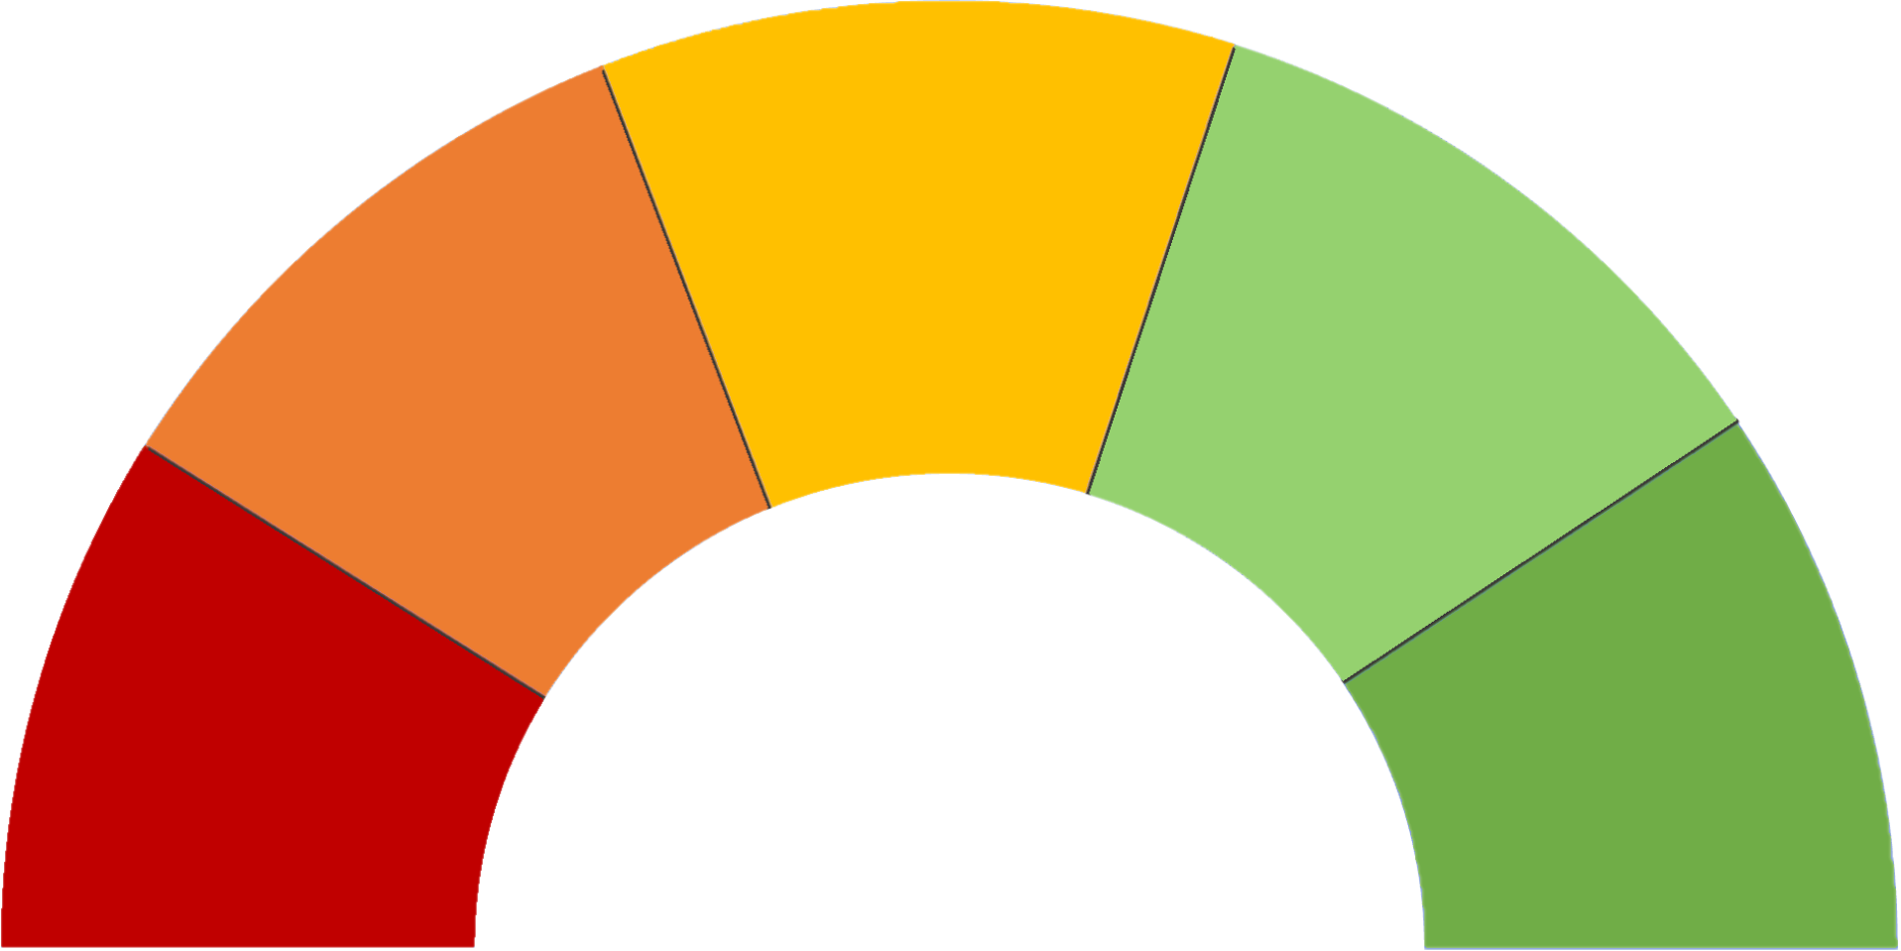
The HOW……continued
The How….continued
y’s Presenters
Request context
Implicit Trust
Level of access permitted
Full Access
Unauthenticated Network Identifiers
Static policy
Allowed
X
No Access
Request context
Zero Trust
Dynamic policy with continuous monitoring
Level of access permitted
Zero Trust
Identity
Device
Increase
Assurance
Application
Limited
Access
No Access
Network
Known
Trusted
Allowed
Full
Access
Infrastructure
Remediate
Data
21
Notes:
Click on items with (i) to show the associated questions

Slide 27
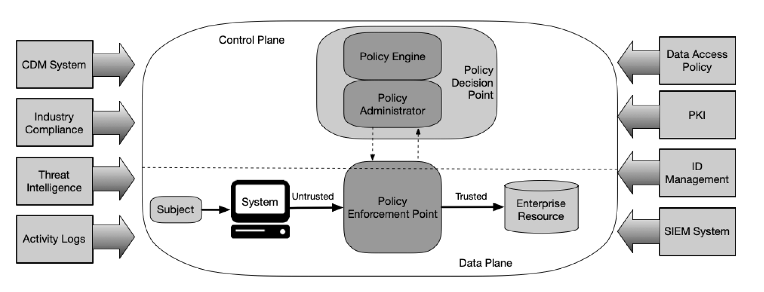
NIST 800-207 Core Zero Trust Logical Components
NIST 800-207 Core Zero Trust Logical Components
22

Slide 28
Modern Security Journey
Modern Security Journey
y’s Presenters
7
Advanced internal and external compliance investigations
Expanding Threat Protection & Intelligence
to Edge
AI-Powered Security
Incorporating
Insider risk
Management
8
9
Enhancement of Threat Protection across Endpoints, Identity and Infrastructure
5
6
2
3
1
Strengthens Auditing Capabilities
4
Ensuring Cloud
Policy and
Application Security
Catching up
Extending
your Identity
and Access
Management
Automatic Data Classification
8
23
Automatic Transcription
Knowledge Discovery
2
3
Meet using any device, any place.
Collaborate with other people on Meeting content

Slide 29
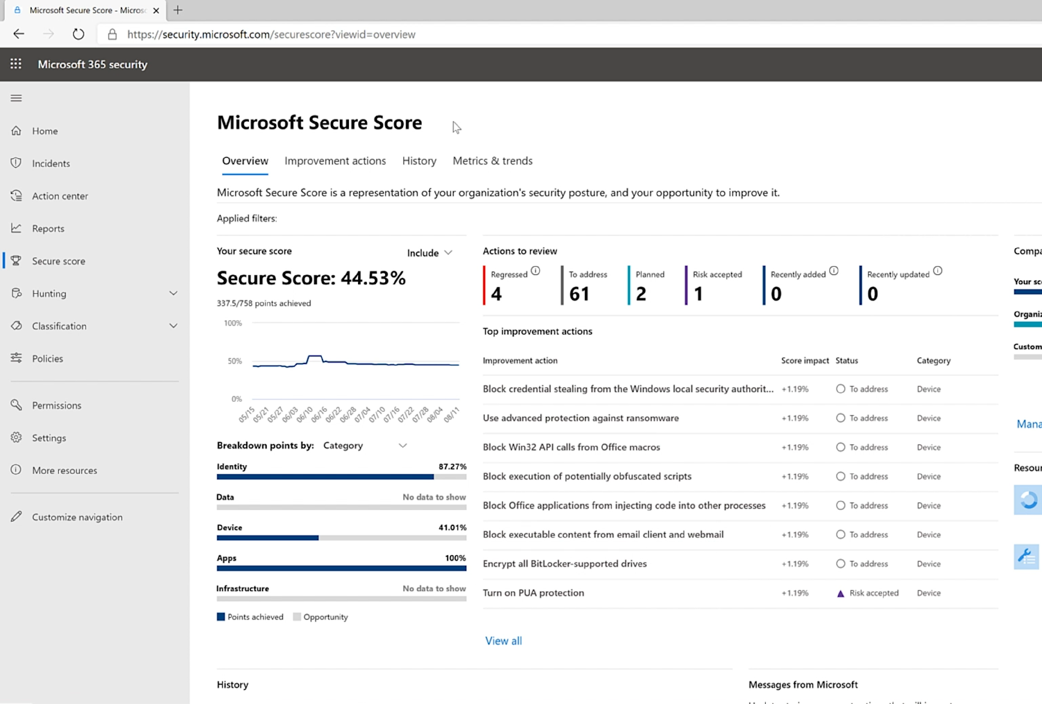
Proactively block threats | Gain insights and take recommended actions before issues occur
Discover risky apps and data Analyze cloud applications that are used without authorization from the IT department. Leverage our scoring based on risk factors to prioritize your actions.
Secure Score
Understand your device estate Reduce risk and helpdesk costs by applying recommended policies, and insights into hardware issues or performance intensive apps through the Endpoint Analytics service
Evaluate your security approach Get a real-time analysis of your current security posture, including recommendations how to improve and compare your score with benchmarks and key performance indicators.
Notes:
Source: https://learn.microsoft.com/en-us/microsoft-365/security/defender/microsoft-secure-score?view=o365-worldwide

Slide 30
Comprehensive Zero Trust Rapid Modernization Plan
y’s Presenters
Comprehensive Zero Trust Rapid Modernization Plan
Roll out to IT Admins first
Targeted by Attackers
High potential impact
Provide technical feedback
Prioritize rapid progress on highest positive impact
Top Priorities – critical security modernization steps
Explicitly validate trust for all access requests (via Azure AD Conditional Access)
User Accounts - Require Passwordless or MFA for all users + measure risk with threat intelligence & behavior analytics
Devices - Require device integrity for access (configuration compliance first, then XDR signals)
Increase security for accessing key resources
Apps – Enable Azure AD for all SaaS, for VPN authentication, and publish legacy on-premises/IaaS via App Proxy
Data - Discover and protect sensitive data (via Defender for Cloud Apps, CA App Control, Microsoft Info Protection)
Governance to continuously monitor security posture and reduce risk (via Secure Score)
User Access and Productivity
Streamline response to common attacks with XDR for Endpoint/Email/Identity+Cloud (via M365 & Defender for Cloud)
Unify Visibility with modern Security Information and Event Management (SIEM via Microsoft Sentinel)
Reduce manual effort - using automated investigation/remediation, enforcing alert quality, & proactive threat hunting
Modernize Security Operations
As Needed – typically driven by cloud adoption or OT/IoT usage
Discover – Find & classify assets with business critical, life safety, and operational/physical impact (via Defender for IoT)
Protect – isolate assets from unneeded internet/production access with static and dynamic controls
Monitor – unify threat detection and response processes for OT, IT, and IoT assets (via Defender for IoT)
Operational Technology (OT) and Industrial IoT
Security Hygiene – Rigorously monitor + remediate security configurations, security updates, MFA, and more Reduce Legacy Risk – Retire or isolate legacy technology (Unsupported OS/Applications, legacy protocols)
DevOps Integration – Integrate infrastructure + development security practices into DevOps with minimal friction
Microsegmentation – Additional identity and network restrictions (dynamic trust-based and/or static rules)
ZT builds on classic security
Align to cloud migration schedule
Datacenter & DevOps Security

Slide 31
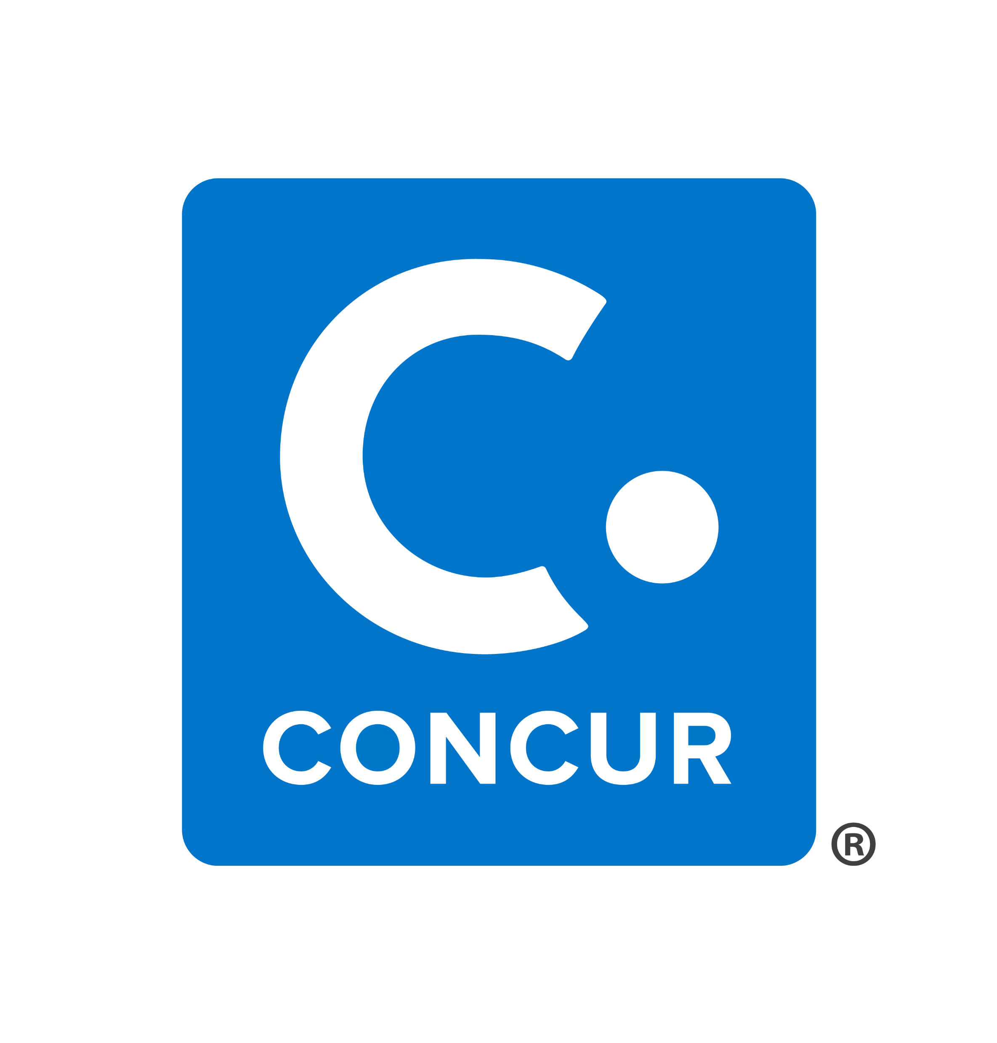
Microsoft and partner solutions for SASE
Microsoft and partner solutions for SASE
Architecture for secure, responsive, and pervasive productivity
Software as a Service (SaaS)
Public and private cloud IaaS, PaaS, on-premises
Sanctioned
Unsanctioned
Outcomes
Key enablers
Policy evaluation + enforcement points
Microsoft capabilities
Partner capabilities
Security
Resilient, simple, adaptable
Cloud Access Security Broker (CASB)
Defender for Cloud Apps
Zero Trust Network Access (ZTNA)
Azure AD App Proxy
Azure VPN
Secure Hybrid Access
Microsoft Tunnel
Measure identity and device security posture
Secure Web Gateway (SWG)
Defender for Endpoint*
Full SWG capabilities
Access policy
Firewall as a Service (FWaaS)
Azure Firewall
Global scale and availability
Software Defined WAN (SD-WAN)
Azure Virtual WAN
On-Prem & multi-cloud
Threat Intelligence
High volume + high diversity
Identity as a Service
Web Application Firewall (WAF)
Azure WAF
Content Delivery Network (CDN)
Azure Front Door
User experience
Slow is the new broken
DNS Protection
Defender for DNS
Other DNS Services/Servers
Azure Active Directory – Passwordless, MFA, Leaked Credential Protections, Behavioral Analytics, PIM, Identity Governance, and more
BYOD and partner devices/users
Managed users and devices
Corporate/IT environment
IoT and OT environment
26
*Microsoft Defender for Endpoint (MDE) addresses many of the use-cases of an internet gateway solution and works with MISA partners to provide full SWG capabilities
Notes:
Key Takeaway: SASE is a flexible security approach that focuses on enabling secure access to resources from anywhere
Like Zero Trust, the Secure Access Service Edge (SASE) approach recognizes the business imperative to enable people to securely work anywhere and access to any resource they need (across multiple clouds and on-premises)
CLICK 1 – Outcomes and Enablers
The key outcomes of a SASE approach of a good user experience and strong security assurances
User Experience - SASE recognizes that user experience and performance are critical in this new world where users believe that “slow is the new broken” .
Security - SASE also follows the same principles of zero trust, where security must design strategies with an assumption of breach (anything could be compromised), trust must be verified explicitly, and provide least privileged using Just-in-Time and Just-Enough-access using risk-based adaptive polices.
To provide these, the SASE approach requires key enablers including:
Global Scale and availability – to ensure that authorize applications are responsive and perform well for users
Explicit measurement User and Device security assurances:
Identities - strong authentication, account isn’t compromised, etc.
Device – compliant configuration, not infected by malware, etc.
Threat intelligence – to inform these security decisions with up to date context (drawn from a dataset that is both high volume and highly diverse). This helps quickly filter out known threats and accurately measure risk (avoiding false positives and false negatives that create business risk or interrupt productivity)
CLICK 2 – Policy Evaluation and Enforcement Points
Making SASE real requires using these enablers to make and enforce access decisions across the diverse set of devices and services that comprise the “edge” of your modern digital estate.
The organization’s Access Policy to considers these signals in the decide whether to grant, deny, monitor, or restrict access for resource access requests.
The policy enforcement points apply this access decision across the estate, ensuring that a consistent policy is applied across SaaS applications, cloud infrastructure, cloud platforms, and on-premises resources.
CLICK 3 – Microsoft capabilities
Microsoft recognizes that no single vendor today has all capabilities required for a full SASE solution. Microsoft is focused on ensuring you can have a complete SASE approach with a combination of native cloud capabilities and by working closely with our Microsoft Intelligent Security Association (MISA) partners.
You can implement a large percentage of SASE concepts today with Microsoft capabilities:
Identity as a Services – Azure Active Directory (Azure AD) provides Identity and Access control for all your cloud and on-premises resources, with integrated security that provides strong assurances for employees, partners (B2B), and customers/clients/citizens (B2C) across any platform or cloud including:
Passwordless and MFA – capabilities to simplify the user experience and strengthen security assurances via Hello For Business biometric authentication, Authenticator App (works on any modern mobile phone), and FIDO2 keys
Identity Protection – against highly prevalent attacks with Leaked Credential Protections, Behavioral Analytics, Threat Intelligence integration and more
Azure AD PIM reduces risk by providing just in time access to privileged accounts using approval workflows
Identity Governance helps ensure the right people have access to the right resources
Azure AD B2B and B2C provide security for partner and customer/client/citizen accounts while separating them from enterprise user directories
Cloud Access Security Broker (CASB) - Microsoft Defender for Cloud Apps (MDCA) provides Cloud Access Security Broker (CASB) capabilities that provide XDR for SaaS applications as well as governance, threat protection, data protection and more for these SaaS apps and the data stored on them. MDCA integrates with other capabilities in Microsoft’s portfolio to extend them to SaaS applications to simplify management and security.
Zero Trust Network Access (ZTNA) – provides Private App/Network Access for devices coming from public networks.
Azure AD App Proxy extends the modern access control approach (security perimeter) to on-premises resources by simplifying user access to them and modernizing security with Conditional Access (which explicitly validates user and device trust, a Zero Trust principle). We also have a strong alliance with our Secure hybrid access partners (link Secure hybrid access - Azure AD | Microsoft Docs) for a complete ZTNA solution.
Azure VPN provides site-to-site and point-to-site VPN access for your resources that aren’t yet provided through Azure AD App Proxy. Azure AD also provides enhanced security assurances for both Azure AD and any existing VPNs you may have.
Microsoft Tunnel for Microsoft Intune provides a VPN capability tailored to the mobile device experience.
Secure Web Gateway (SWG) – Microsoft Defender for Endpoint is NOT classified as a Secure Web Gateway product but addresses many of the use-cases of an internet gateway solution, such as web content filtering, from the endpoint. Microsoft also works with our MISA partners that provide a full SWG using network traffic interception.
Firewall as a Service – Azure Firewall provides a managed, cloud-based network security service that helps protect resources accessed via Azure networks (including TLS Inspection, IDPS, URL Filtering, and Web Categories). Microsoft integrates with partners that provide this capability for resources accessed via on premises and on 3rd party cloud networks.
Web Application Firewall (WAF) - Azure WAF provides centralized protection of your web applications from common exploits and vulnerabilities accessed via Azure networks. Microsoft integrates with partners that provide this capability for resources accessed via on premises and 3rd party cloud networks.
Software Defined WAN (SD-WAN) - Azure Virtual WAN is a networking service that brings many networking, security, and routing functionalities together to provide a single operational interface. This is available in Azure regions around the globe integrates with many partner offerings.
Content Delivery Network - Azure Content Delivery Network (CDN) offers organizations a global solution for rapidly delivering high-bandwidth content to users by caching their content at strategically placed physical nodes across the world.
DNS Protection - Microsoft Defender for DNS provides protection for resources that use the Azure DNS’s name resolution capability. Partner solutions can provide additional protection for other name resolution capabilities.

Slide 32
Microsoft Intelligent Security Association
Microsoft Intelligent Security Association
Independent software vendors

Slide 33
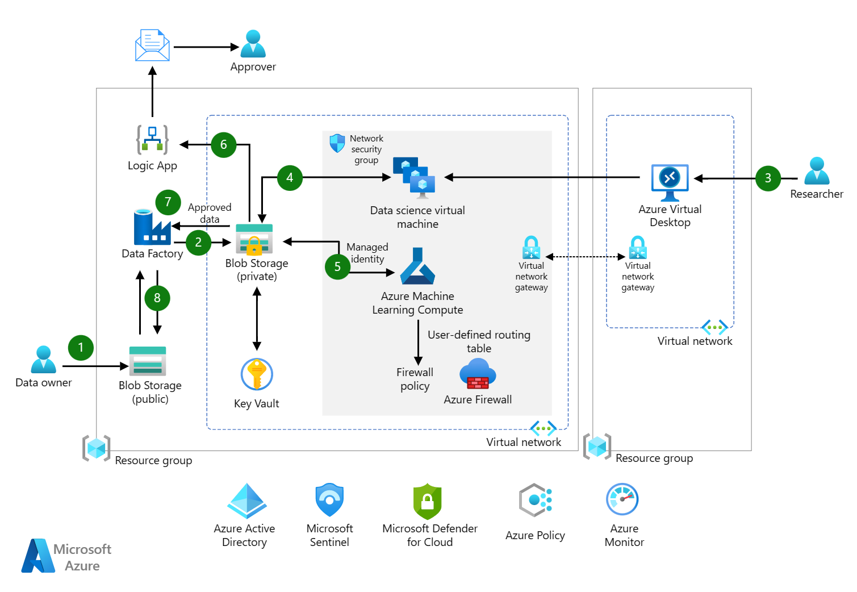
Secure Research Enclave
Secure Research Enclave
Example of Rapid Deployment Template
28

Slide 34
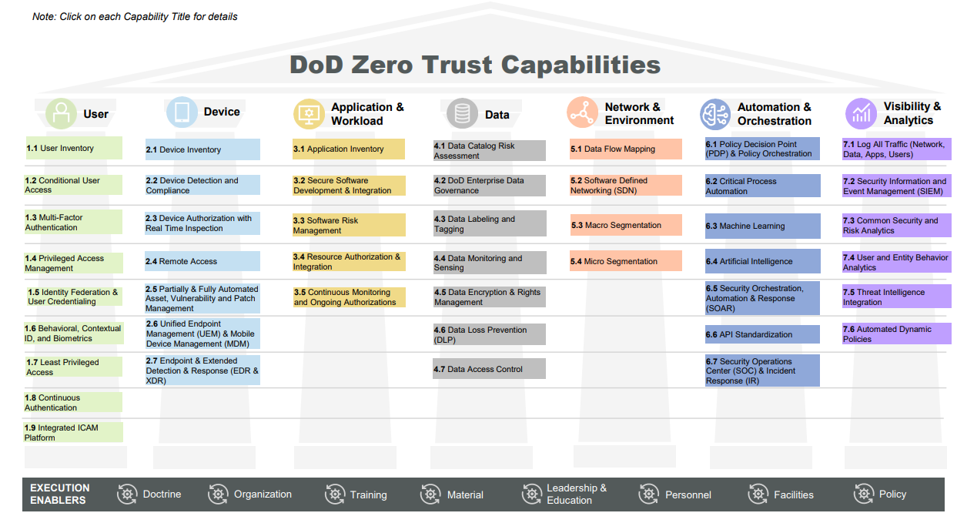
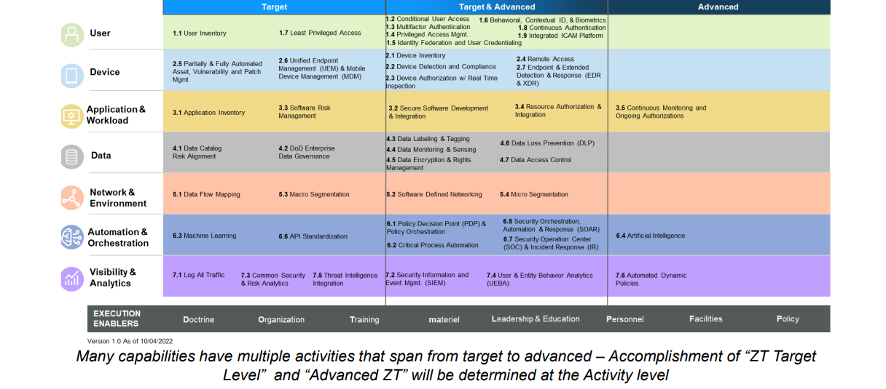
Department of Defense Zero Trust Adoption
Department of Defense (DOD) Zero Trust Adoption
29

Slide 35
Securing Critical Infrastructure and Hybrid Cloud
What is a Security Roadmap?

Slide 36
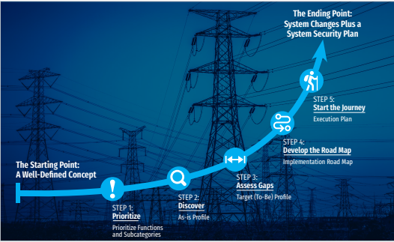
Incremental Actions into Building a Security Roadmap
30

Slide 37
Defining a Security Roadmap
Defining a Security Roadmap
y’s Presenters
A security Roadmap is customized/ unique to you plan that follows a defined framework that is useful to you.
7 Common Industry Standard Frameworks
NIST CSF
CIS
ISO 27001 and ISO 27002.
SOC2.
NERC-CIP.
HIPAA.
GDPR.
FISMA
31
Notes:
Here is a list of the 7 common Security Frameworks out there. I’ve highlighted the ones that I believe are the “easiest” to follow based on the needs of Education environments.
Please note- these 2 maybe the easiest, but they are still very comprehensive. One of the common complaints that many organizations have is the difficulty in migrating to using one of these frameworks.
While it is true that all frameworks share common actionable points, Like Identifying, detecting and Protecting the people, process, technology and data that is needed to be secured; there are still baseline assumptions built in that most organizations are not able to function at in their current steady state.

Slide 38
Fundamentals for Effective Security Design
Fundamentals for Effective Security Design
y’s Presenters
Are you aligned for a useful framework ?
Identify
Protect
Detect
Know what is on your network, where your users connect from and where they are sending data to
Establish and maintain control over every edge
Hardware, applications, operating systems, network security devices and controls, All things that connect or share data
Deployed security solutions need access to common datasets across all network edges, endpoints, and clouds
Security framework needs to support and enable advanced data analysis
Automatically create new protections across the full attack cycle
SEC OPS needs to rapidly launch a coordinated threat response across the entire ecosystem the moment a threat is detected
Change is the only constant in today’s digital world, a security fabric needs to be dynamic
Security should be designed to scale up and out as the network it is securing evolves and adapts
32
Notes:
This is a simplified view of the start of creating a security roadmap using a skeleton of the NIST CSF and common sections of the CIS controls. Again this is just a starting point to get you moving down the road. For many of these actionable steps, you may need to deploy technology to help you be able to fufill the general steps- e.g. You may need software technology such as Asset Mgmt, External vulnerability testing, and Network Analyzers to help in the discovery of the hardware/software/people/Data on your digital surfaces.

Slide 39
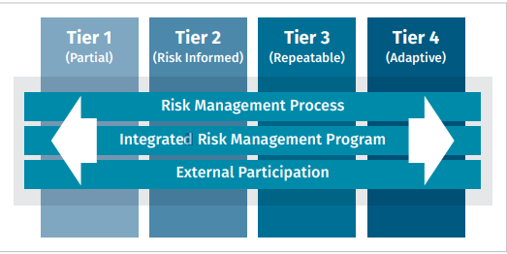
Working up to the NIST CSF- Good/Better/Best approach
Working up to the NIST CSF- Good/Better/Best approach
y’s Presenters
Are you aligned to a useful framework?
Good
Better
Best
Implement Highest Priority Security Concerns
Implement MFA as a baseline to get to Zero Trust
Fix Known Security Flaws/ patching
Perform and Test Backups
Minimize attack surface/ exposure
Develop and exercise a cyber incident response plan
Create a training and awareness campaign at all levels
Move on from “Good” and start to take a more “Security Controls Based Approach”
Prioritize further near-term investments
Recommend using CISAs 37 CPGs
Full adoption of the NIST CSF
Many times, requires outside consulting to help provide an unbiased view and assessment to help in the GAP analysis
Focused most on Risk Tolerance
33
Notes:
This idea breaks apart the heavy lift of trying to address the people/process/technology facet of Security into a 3-step process. Please note that each of these bullet points will require you to run the Identify/Protect/Detect rubric to each The “Good Column” is heavy on technology investment first. MFA: a layered approach to securing online accounts and the data they contain. Even if one factor (such as a user password) becomes compromised, unauthorized users will be unable generally to bypass the second authentication requirement, ultimately stopping them from gaining access to the target accounts. Not all MFA methods provide the same level of protection. Some MFA types are better than others. Phishing resistant MFA is the standard all leaders should strive for, but any MFA is better than no MFA. MFA implementation can be challenging. We have observed that some organizations have instructed their users to enroll in MFA, but not all users complete that task. There are often MFA gaps for recently onboarded staff and for people who have migrated to a new phone. In addition, the recommended phishing-resistant MFA tools are often available only at an additional cost. Finally, many educational technology applications have their own MFA. Given these challenges, including costs, you should consider whether networks might benefit from a comprehensive single sign-on (SSO) solution that centralizes identity and access management (IAM) controls. Focus on High priority systems first and then move on to all others
Patching: Many attacks succeed because victims were running vulnerable software when a newer and safer version was available. Keeping systems patched is one of the most cost-effective practices an organization can adopt to enhance its security posture. All entities should sign up for CISA’s free Vulnerability Scanning service to receive weekly reports on vulnerabilities accessible via the internet and prioritize fixing vulnerabilities listed in CISA’s Known Exploited Vulnerabilities (KEV) Catalog. Being a part of MS-ISAC/ Ren-ISAC, or even using our Fortinet’s Fortiguard services (which ingests all major threat feeds from GOV’ts to trusted 3rd parties) via IPS enforcement is an easy button to utilize automated protection before a threat occurs.
Backups: Many organizations who have fallen victim to damaging intrusions such as ransomware either had no backups or had incomplete/ damaged backups. Orgs should back up all key systems regularly, and also regularly test partial and full restoration of data. This practice should be documented in a written plan. Backups should be stored offline and disconnected from the network. As part of the entities’ governance program, leaders should request, and review evidence of the test restoration tasks and workplans to address any gaps found during the restoration exercise.
Minimize exposure: Many threat actors find vulnerable targets by scanning the internet for exploitable services. Orgs should ensure that IT assets accessible via the internet do not expose frequently exploited services. Any exposed system must have strong compensating controls in place and be reviewed as part of the governance program. Because attackers frequently compromise Remote Desktop Protocol (RDP) servers and other public portals, organizations should have their External asset security plan reviewed by both management and outside experts.
Develop IRPs- leaders and administrators need to know how to respond to cyber incidents, including how to recover should adverse events occur. Every organization should establish and regularly exercise a written incident response plan (IRP), which should define what the organization needs to do before, during, and after an actual or potential security incident. It should include roles and responsibilities for all major activities and be approved by the most senior leader of the organization. Where possible, organization-level IRPs should be integrated into a district’s broader emergency operations plan. Successful teams rehearse their plans. Organizations should test their plans by hosting attack simulation exercises with the personnel identified in their IRP. Sometimes called “tabletop exercises” or “TTXs,” these simulations allow teams to prepare for the inevitable security incident during peacetime. The lessons learned from these exercises will allow the organization to update and strengthen their IRP as well as their policies, procedures, and even technologies.
Security Awareness training: The cybersecurity field is not just about technology; it is also about people. Good training focuses on both awareness and enablement. When people on the front lines see something suspicious, do they know how to report it? Do the people who receive the report know how to act appropriately? Investment in training is just as important as investment in cybersecurity capabilities, tools, and solutions. Staff training at all levels is a prerequisite to progress. While leadership, staff, and student time is limited, initiating positive change and driving cyber awareness at all levels is within reach.
Better: KEY CHARACTERISTICS OF THE CPGs • A prioritized subset of cybersecurity practices • For IT and OT • Prioritized for risk reduction • Informed by threats observed by CISA and its government and industry partners • Applicable across all CI sectors • Intended to meaningfully reduce risks to both CI operations and to the American people
Focuses heavily on Cost/Impact/Complexity
The CPGs in this document are displayed in a visual model to help readers understand not only the goals themselves, but the intended outcomes, the risks or TTPs that the goals address, what ‘good’ looks like, and other important information. Each goal is composed of the following components:
The ultimate security outcome that each CPG strives to enable.
1)Outcome
2) TTP/Risk Addressed Either (a) the primary set of MITRE ATT&CK TTPs or (b) the set of organizational risks that would be rendered less likely or impactful if the goal is implemented.
3) Security Practice The mitigation(s) that organizations should implement to achieve the outcome and reduce the impact of the TTP or Risk.
4) Scope The set or subset of assets to which organizations should apply the security practice.
5) Recommended Action Example approaches to help organizations progress toward achievement of the Performance Goal, based on input from CISA’s collaborative stakeholder process. These actions will be updated regularly as new threats and defenses are identified.
6)NIST CSF Reference The CSF subcategory that most closely relates to the security practice.
Best:
The CSF is a robust framework for building and maintaining a comprehensive information security program. Governments and enterprises use it to ensure they have covered all the key elements of a mature program. The final step here is to most likely get outside help either through consulting services or other organizational needs.

Slide 40
Sign Up: Complimentary Security Assessments
Complimentary Security Assessments
y’s Presenters
Join SafePC, Microsoft, and Fortinet for a free in-depth report across key Cybersecurity areas
NGFW (Firewall) Risk Assessment
Email Security Risk Assessment
SD-WAN Risk Assessment
Executive Summary
We aggregated key findings from our HGFW assessment within the Executive Summary Below. While the highlights are listed below, a more detailed view of each section follows. Be sure to review the Recommended Actions page at the end of this report for actionable steps your organization can take to mitigate inbound threats, implement corporate use policies, and avert capacity planning issues.
Executive Summary
We aggregated key findings from our email risk assessment with the Executive Summary below. As represented in the summary, this report is divided into three sections: Security, Productivity, and Utilization. While the highlights are listed below, a more detailed view of each section follows. Be sure to review the Recommended Actions page at the end of this report as well for actionable steps your organization can take to mitigate email borne threats and optimize your overall email experience
Executive Summary
We aggregated key findings from our Secure SD-WAN assessment within the Executive Summary below. While the highlights are listed below, a more detailed view of each section follows. Be sure to review the Recommended Actions page at the end of this report as well for actionable steps your organization can take to optimize your network for Direct Internet Access (DIA), protect your organization from threats, and ultimately save money.
Security
Security
Applications
11,126
Application Vulnerability Attacks Detected
13
Malware and/or Botnets Discovered
17
High Risk Applications Detected
842
Know or Suspected Attachment-based Attacks
52
Know or Suspected URL-based Attacks
4
Known or Suspected Impersonation-based Threats
143
External (Potential DIA) Applications
22.8%
Percentage of Cloud IT Traffic
5.8%
Percentage of VoIP/Audio/Video Traffic
Note that any threats observed within this report have effectively bypassed your existing network security gateway, so they should be considered active and may lead to increased risk (such as a data breach)
Note that any threats observed within this report have bypassed your existing email security solution, so that should be considered active and potentially dangerous
Applications usage should have a strong influence on your network architecture. Understanding which types of applications are used and specifically business application performance can improve used experience and productivity
Productivity
Productivity
Security
330
Total Applications Detected
5
Total Proxy Applications Detected
5
Total Peer to Peer Applications
415, 225
Emails Flagged as Spam
19,925
Suspected Newsletters
1,647
Emails Detected with Adult Content
11,126
Applications Vulnerability Attacks Detected
13
Malware and/or Botnets Discovered
17
High Risk Applications Detected
Applications usage should have a strong influence on your network architecture. Understanding which types of applications are being used can affect corporate use polices, controls on segmented networks, and utilization of cloud-based service platforms.
Although not necessarily malicious span, newsletters and/or emails with adult content represent a potential nuisance and/or offense. Organizations should consider whether the current level of unwanted or inappropriate email is acceptable.
Maintaining a full security stack at the WAN edge is critical in any SD-WAN deployment where public internet circuits are leveraged. Note that any threats observed within this report have effectively bypassed your existing network security gateway, so they should be considered active and may lead to increased risk (such as a data breach)
Utilization
Utilization
Utilization
40.5GB
Total Bandwidth Used
12.5
Average Log Rate per Second
58.0%
Percentage of SSL Encrypted Traffic
15,215
Average Emails Processed Per Day
1.6GB
Average Email Bandwidth Per Day
110.6KB
Average Email Size
40.5GB
Total Bandwidth Used
23.5%
Percentage of Non-Business Traffix
58.0%
Percentage of SSL Encrypted Traffic
35
In addition to individual applications, understanding overall utilization can help with capacity planning and streamlining network traffic over time.
Although you may have moved to cloud-based email infrastructure, utilization statistics can be valuable in a number of ways, they can be used to compare your email utilization against industry norms. Daily usage numbers can be tracked over time; deviations analysis is also helpful when determining anomalous company-wide behavior.
In addition to individual applications, understanding overall utilization can help with capacity planning, circuit selection, and streamlining network traffic over time. This awareness can also help reduce operational costs associated with backhauling traffic over more expensive WAN links (such as MPLS)

Slide 41
Benefits
Solutions
y’s Presenters
Provide assistance for the Higher Education Emergency Relief Fund (HEERF), and other grant resources which assists with broadband, IT infrastructure, and cybersecurity
Complimentary Cybersecurity Threat Protection Assessments
Complimentary Training with the Microsoft Team for your employees to improve security awareness
Special Education Pricing on Surface and OEM Devices
For further inquiries, please email Madinah Ali at msali@safepcsolutionsusa.com

